Slide 1
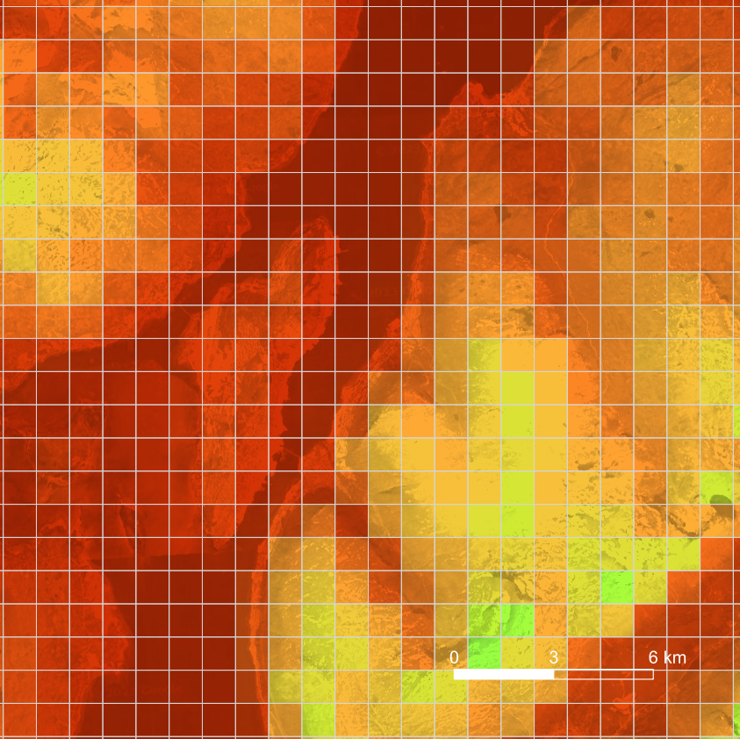
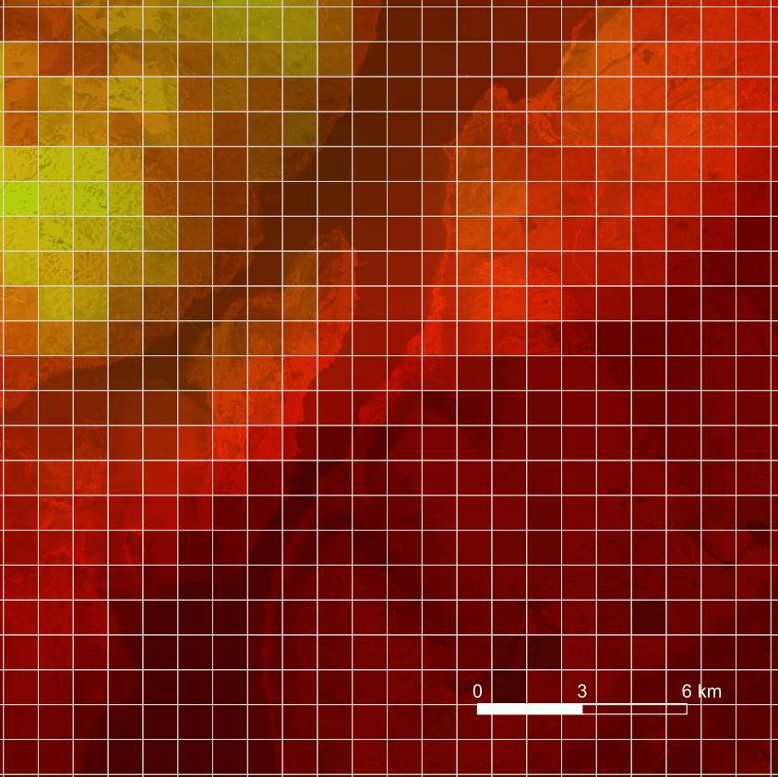
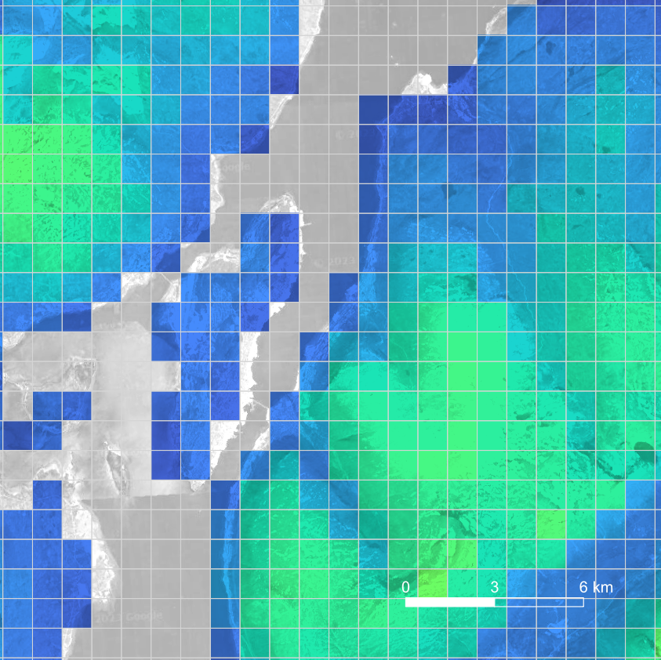
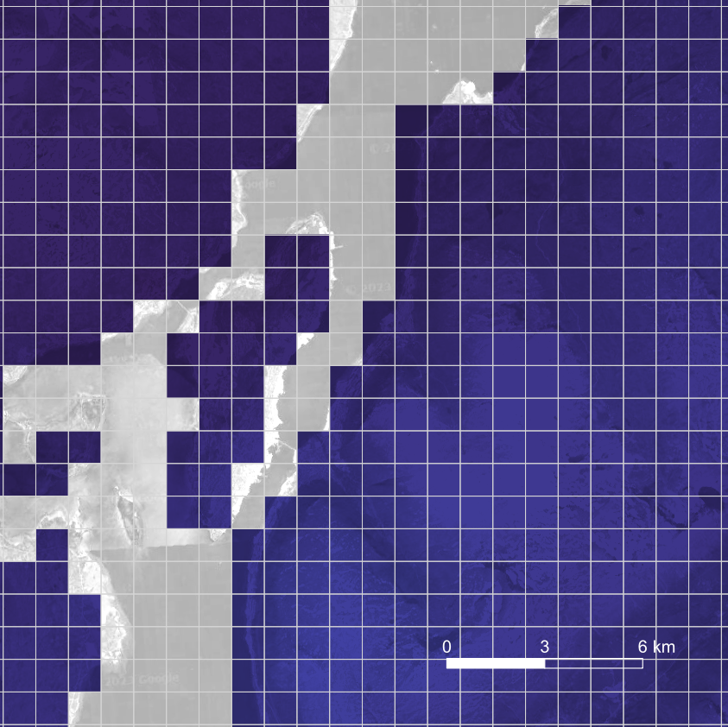
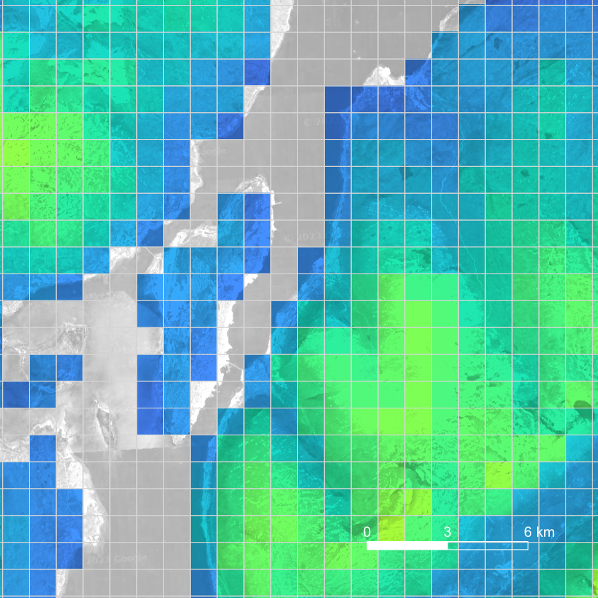
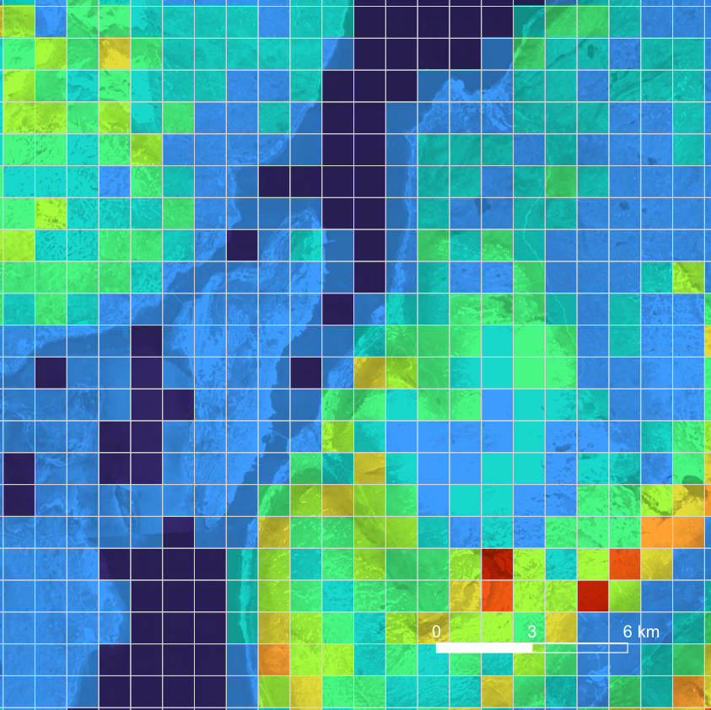
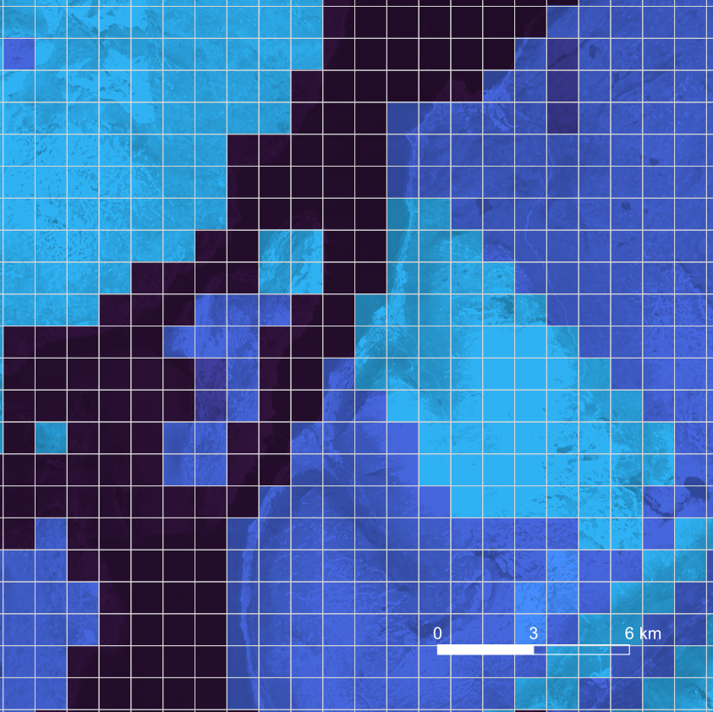
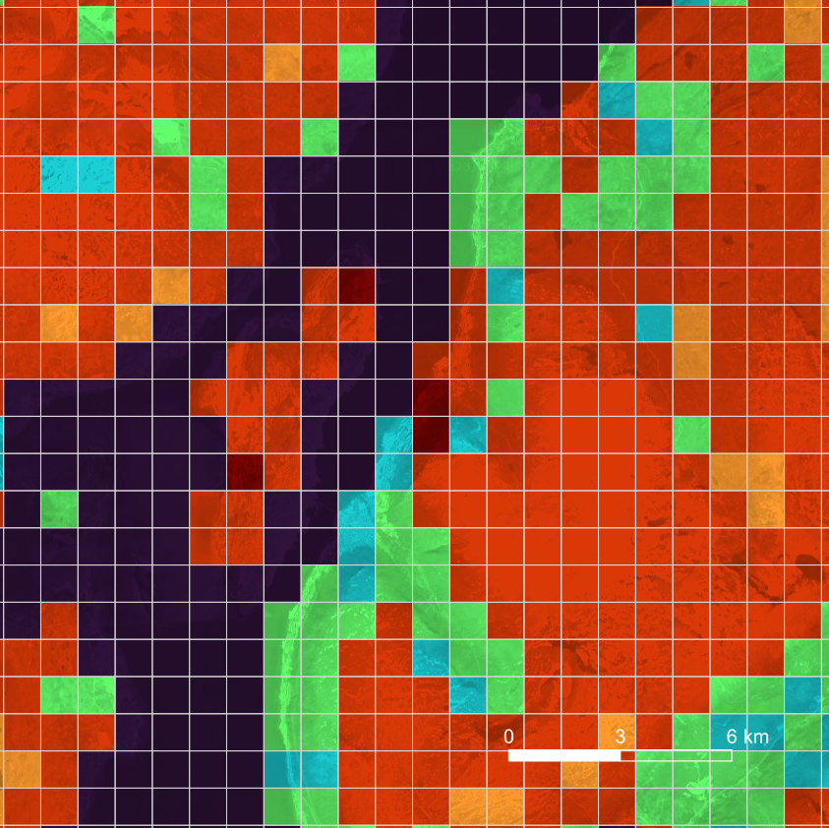
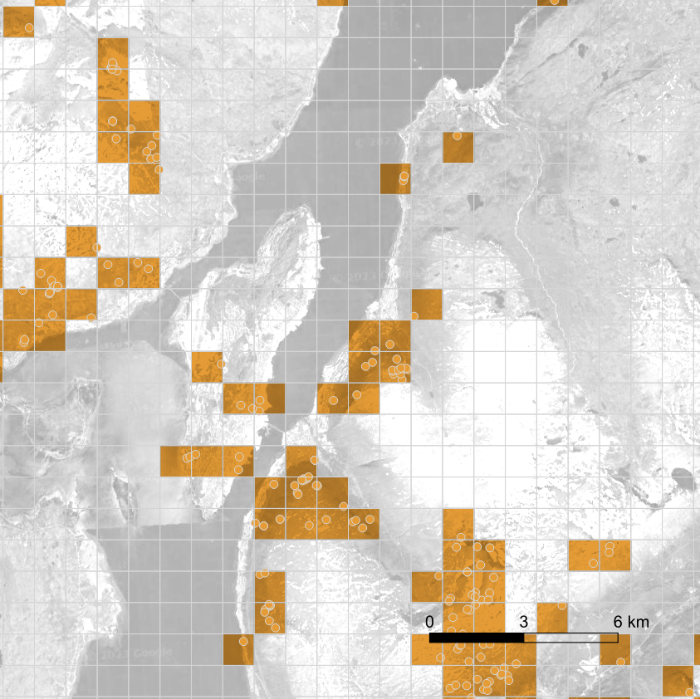
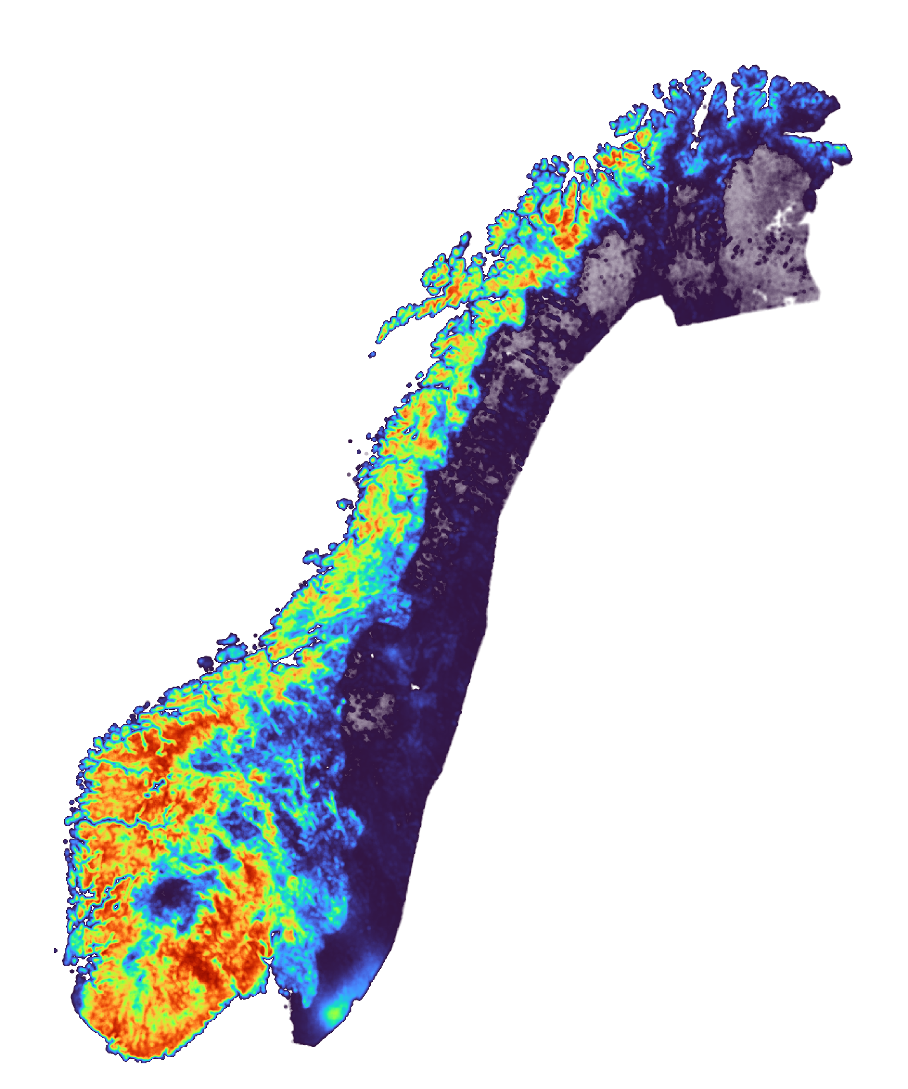
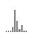
S_{k}
G_{k}
Specify Date (Month, Date, Year)
Aggregating the performance of k = 32 models comprising the ensemble
Features
Input, I_{k}
Two Graphical Structures, G_{k}
(by similarity and by proximity)
Model, M_{k}
Subdataset, S_{k}
S_{k}
G_{k}
Initialized Weight
optimal combination of 7 features
Attribute-aware, G^{A}_{k} (cosine similarity value > 0.50)
Normalize
random sampling
yes
start?
no
Optimizing Weight
Labels
or
incident
Propagation
non-incident
Activation Function
Susceptibility Map
Neighborhood-aware, G^{N}_{k} (Euclidean distance < 12km)
Addition
neural network
perform 5 times?
no
yes
Average
(50th-percentile)
Propagation
Regularize
label
feature
Inverse Logit – to transform values to be [0,1]
Distribution of 32 predictions
(only illustrative)
actual = 20 times longer
(only illustrative)
actual = 200 times more
Predictions
Final Weight

Slide 2
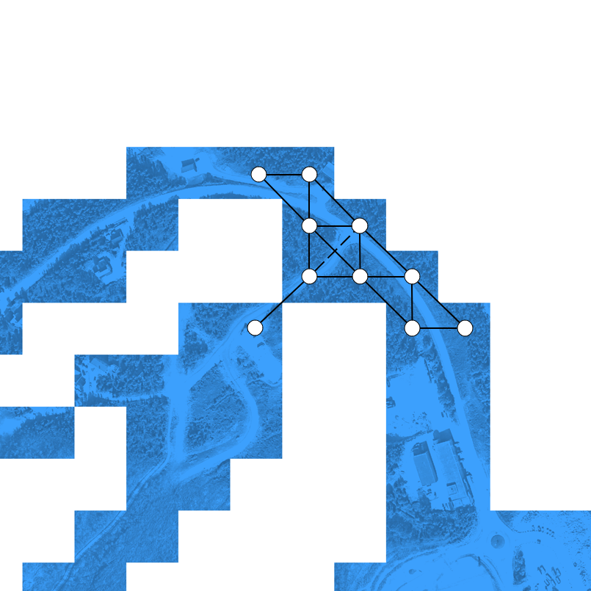
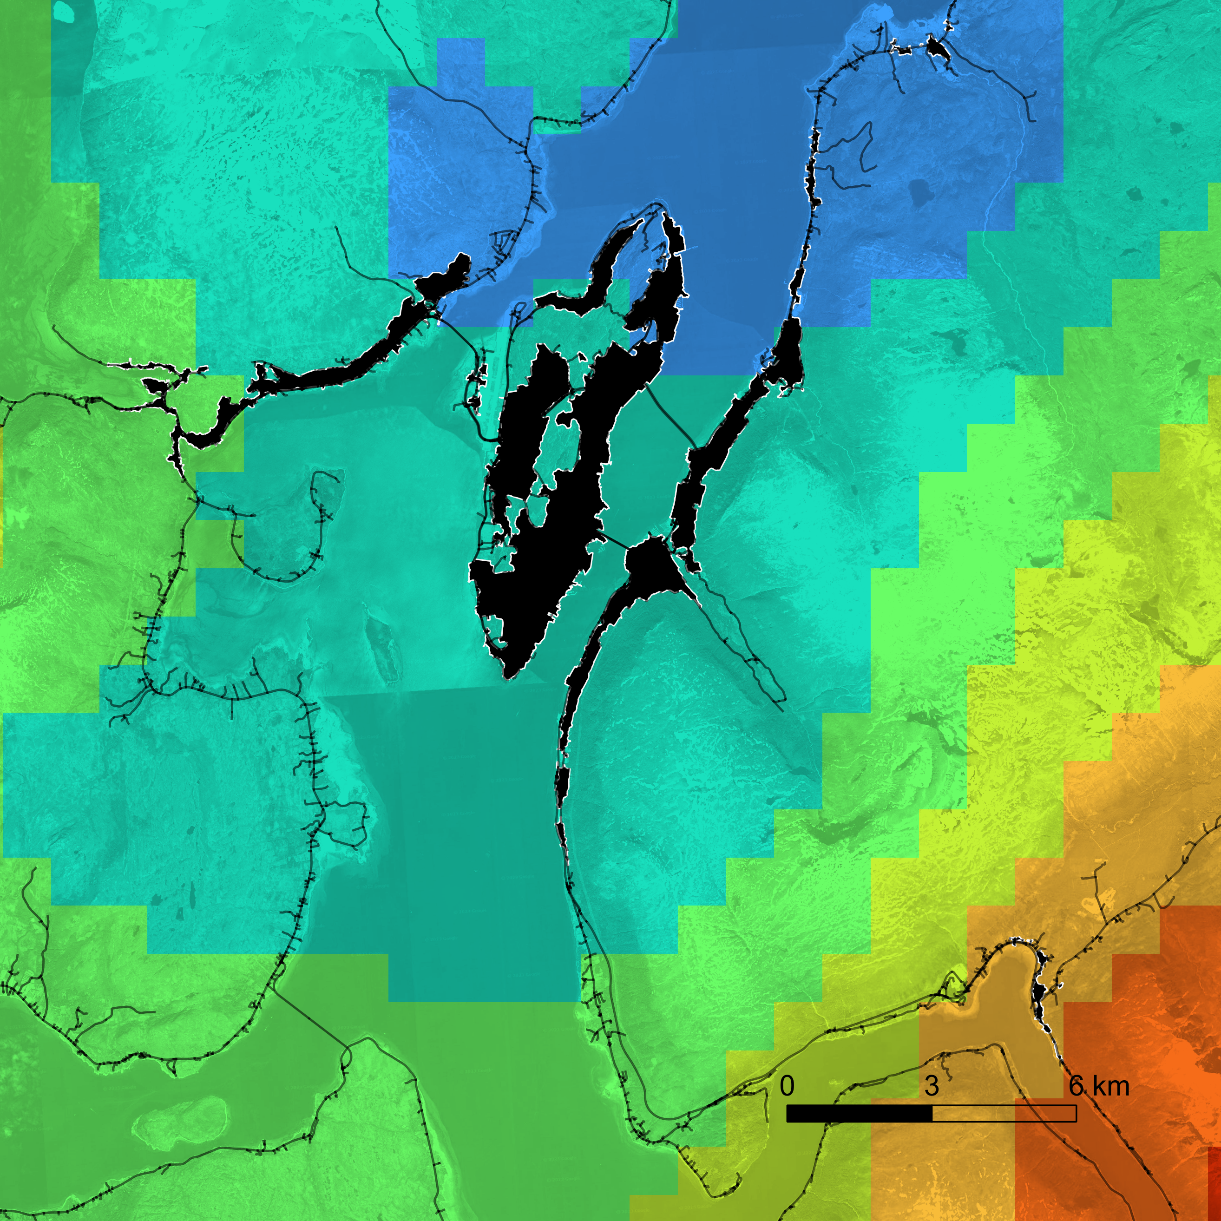
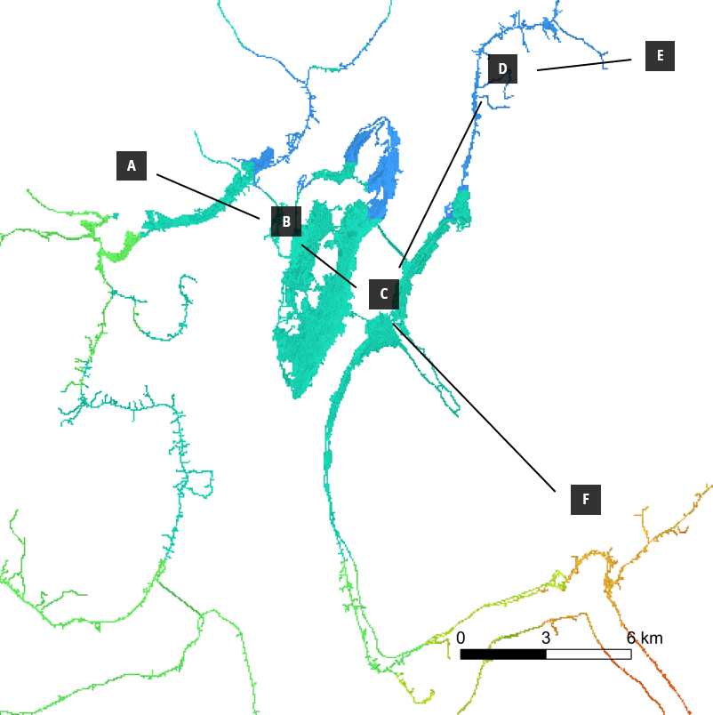
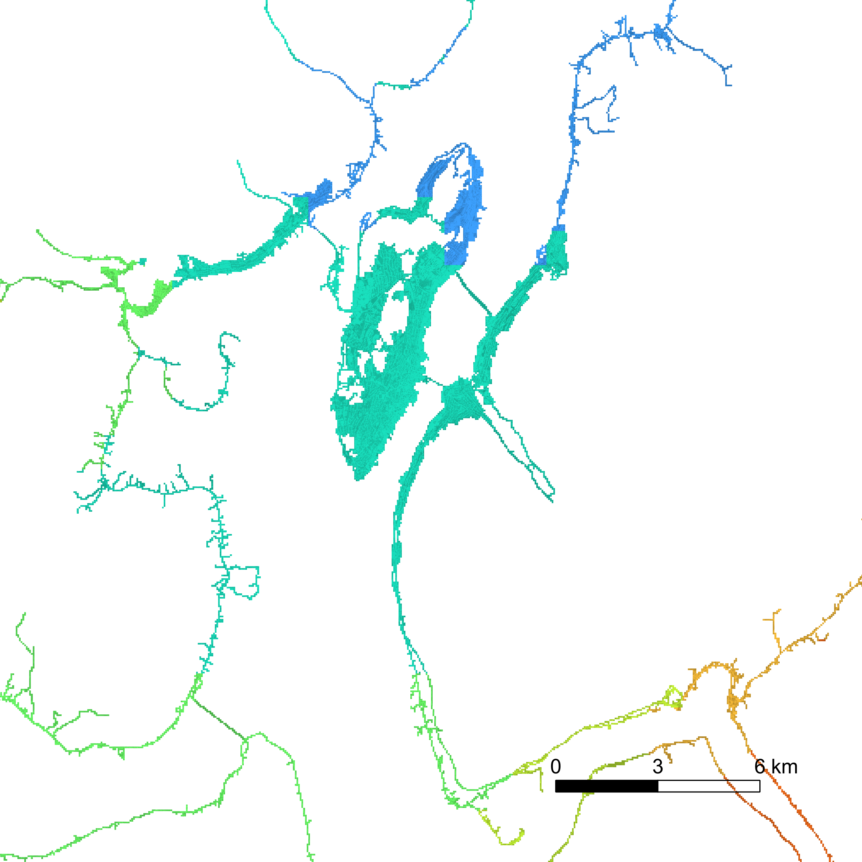
Preprocessing
Initial Graph of Grid Points
Derived Graph of Settlements
Specify County Mask
Extract any random point within the settlement vicinity
Settlement Node
Susceptibility Map
Extract the shortest path
between any two settlements
Shortest Path
Extract maximum susceptibility along the shortest path
Edge Weight
Road Networks
Construct a new adjacency matrix with settlement as nodes
Construct a simplicial network
Increase cutoff value
from 0 to 1
Settlements
Transform into weighted unnormalized Laplacian matrix
Perform iterative K-means clustering
Reduce the resolution to 50m
from 1km (of susceptibility map)
Inter- and Intra- Settlement Exposure Probability
Map Data ©2023 Google
Map data ©2023 Google, Norwegian Mapping Authority

Slide 3



D
0.25
E
A
0.30
0.29
B
0.31
C
0.44
F
0
1
Map Data ©2023 Google

Slide 4
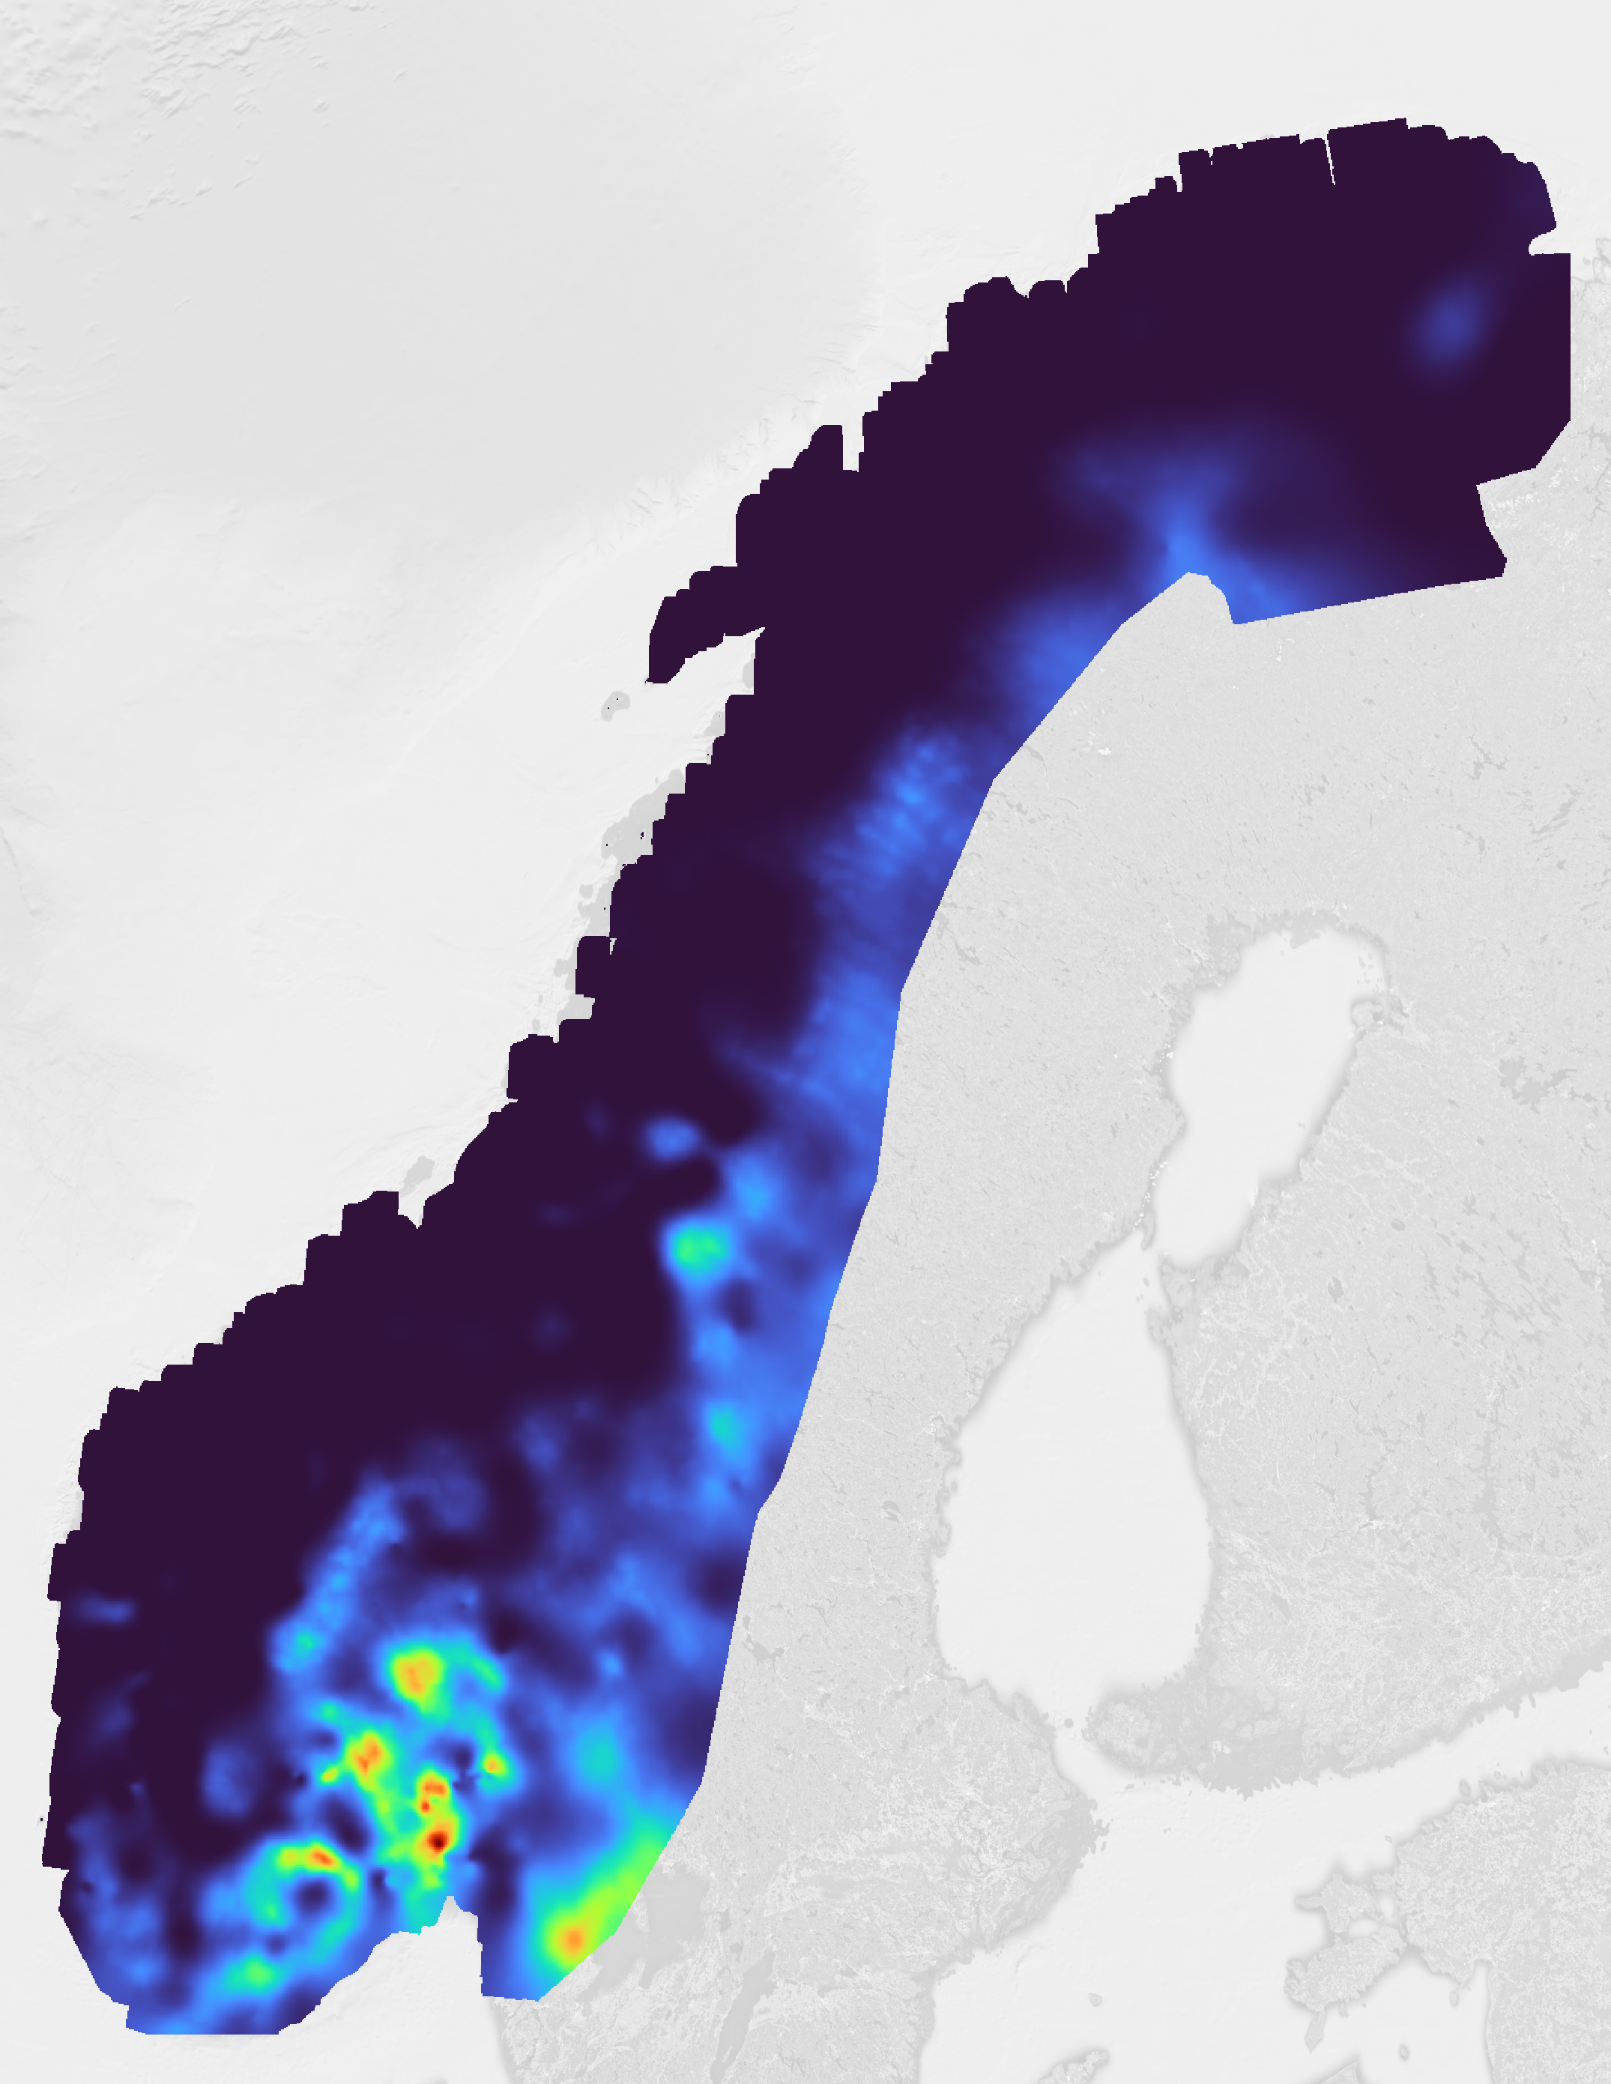
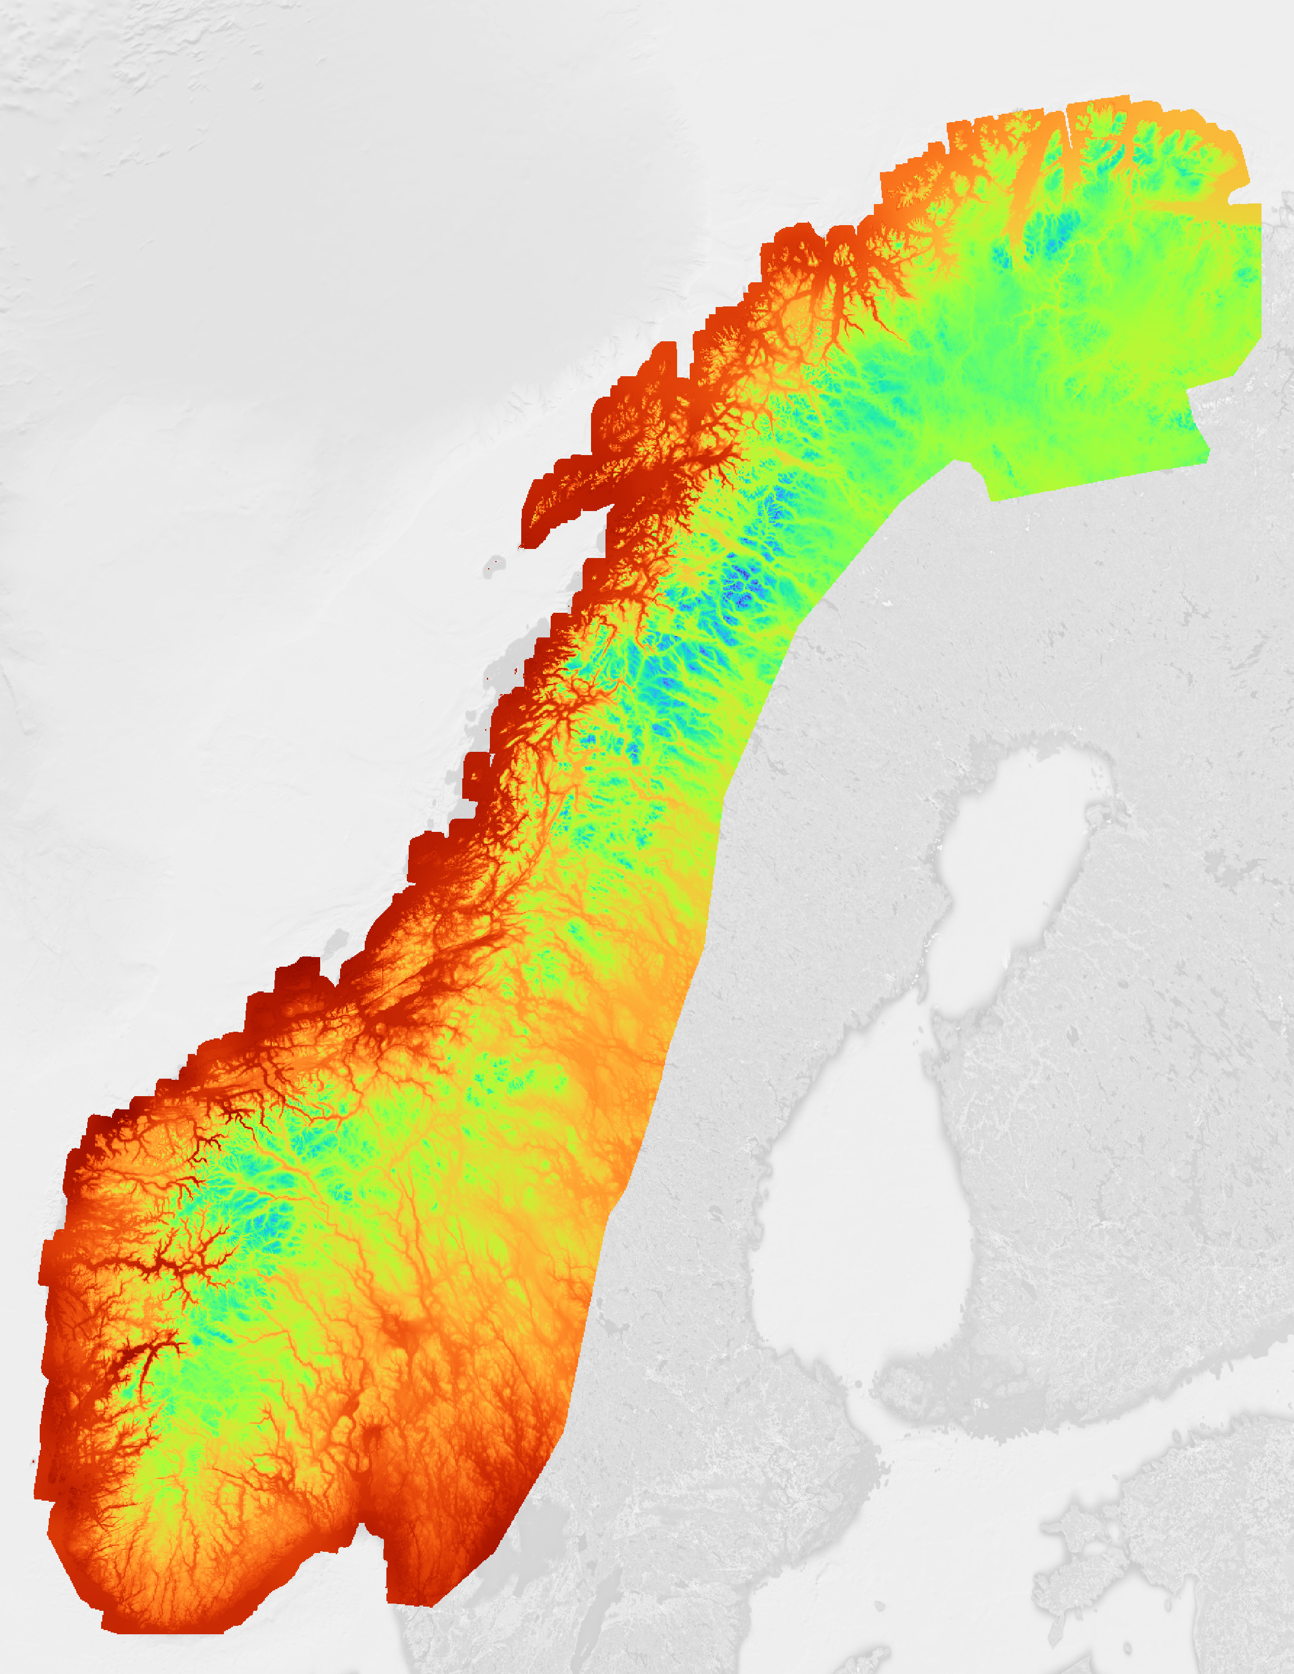
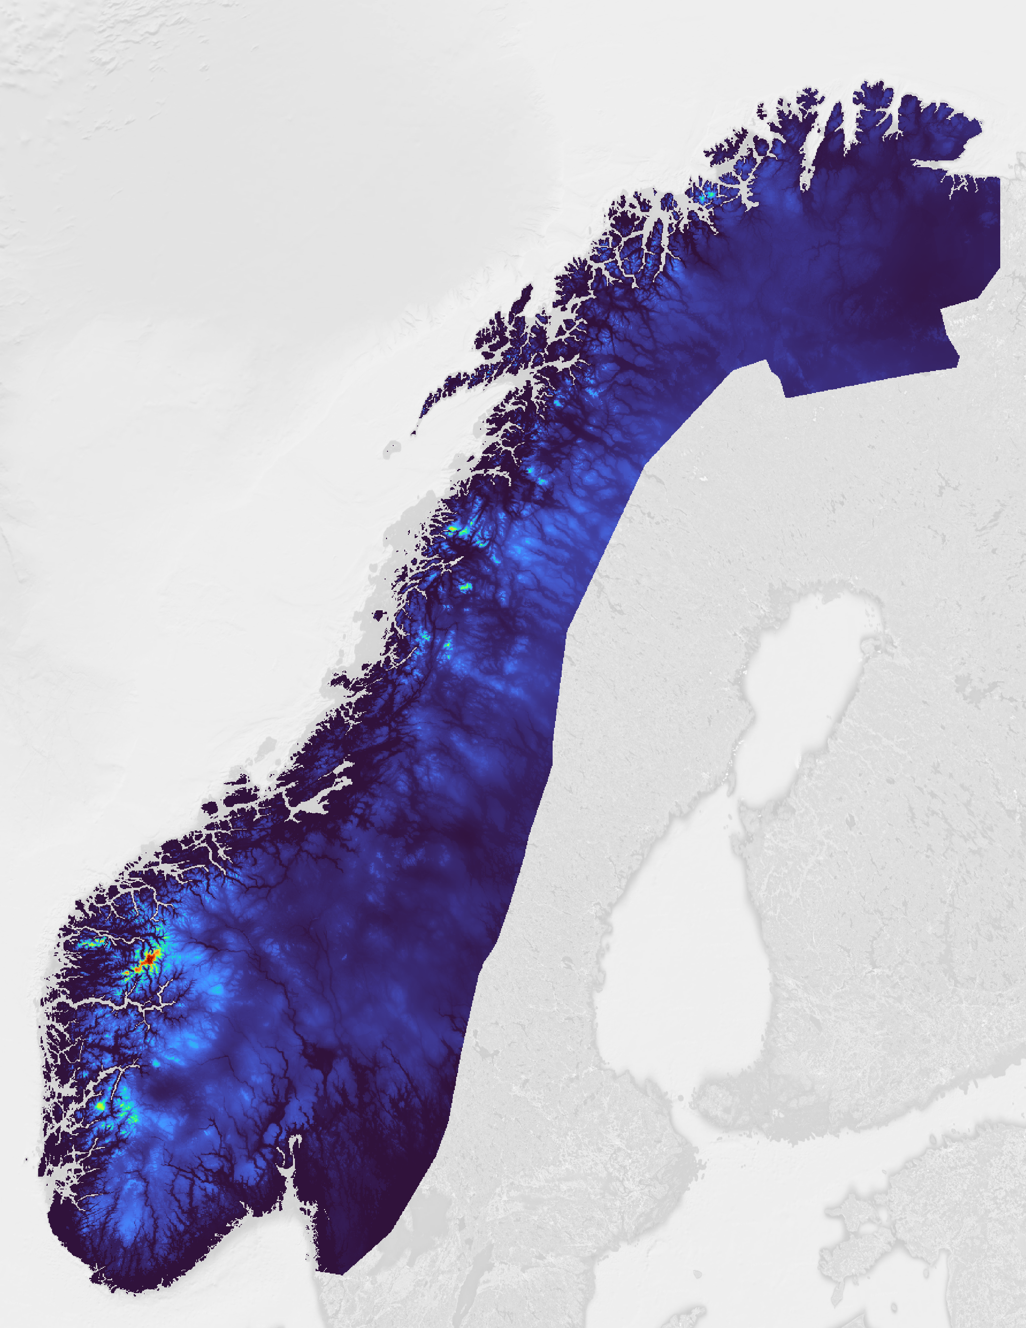
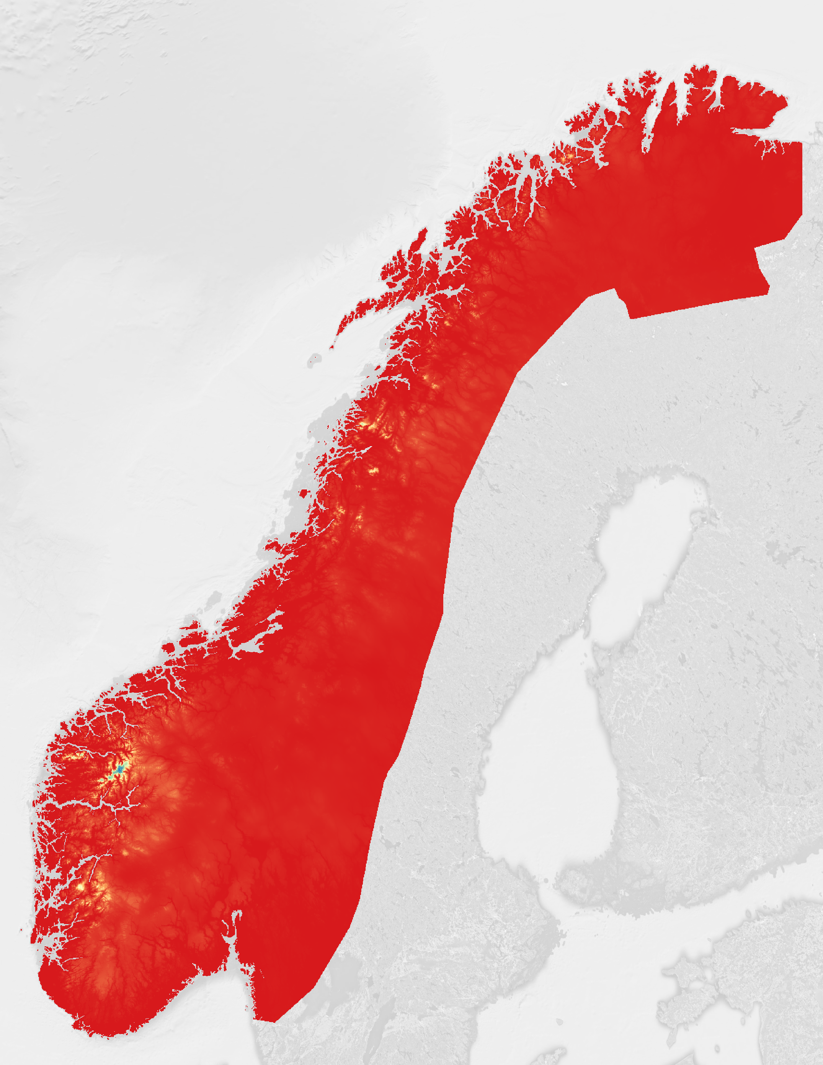
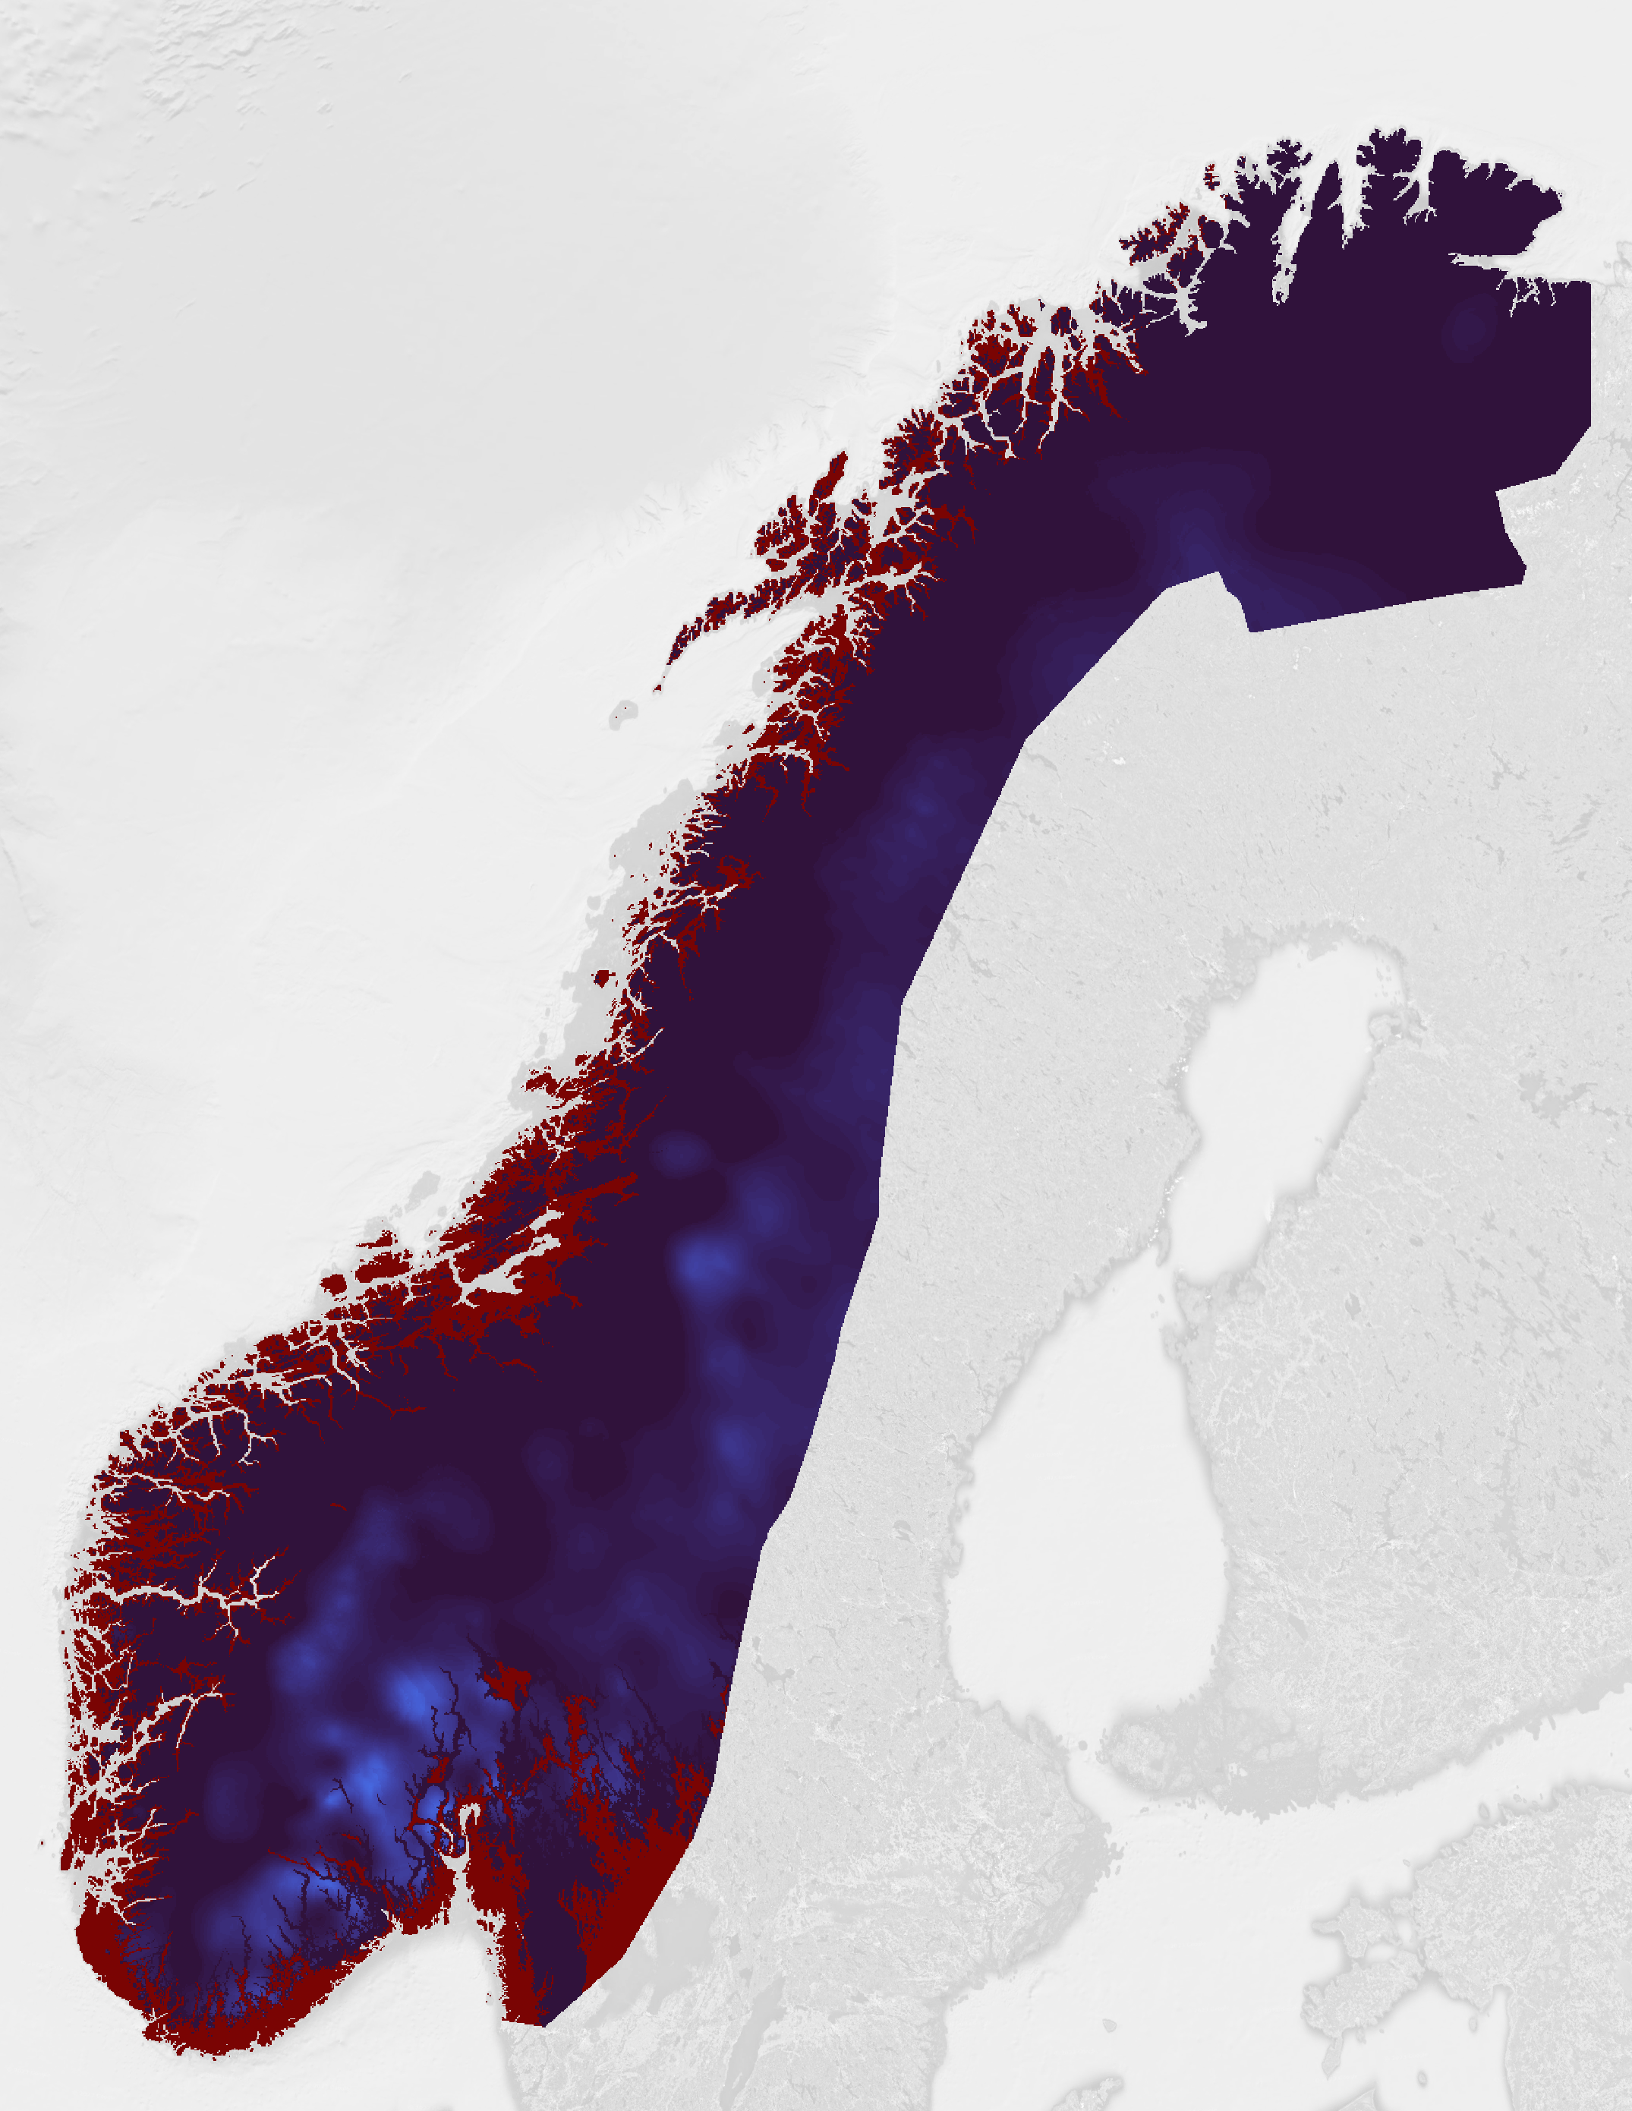
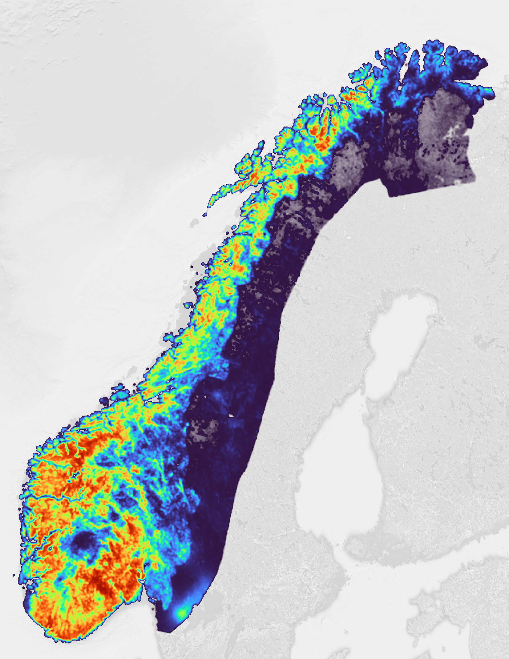
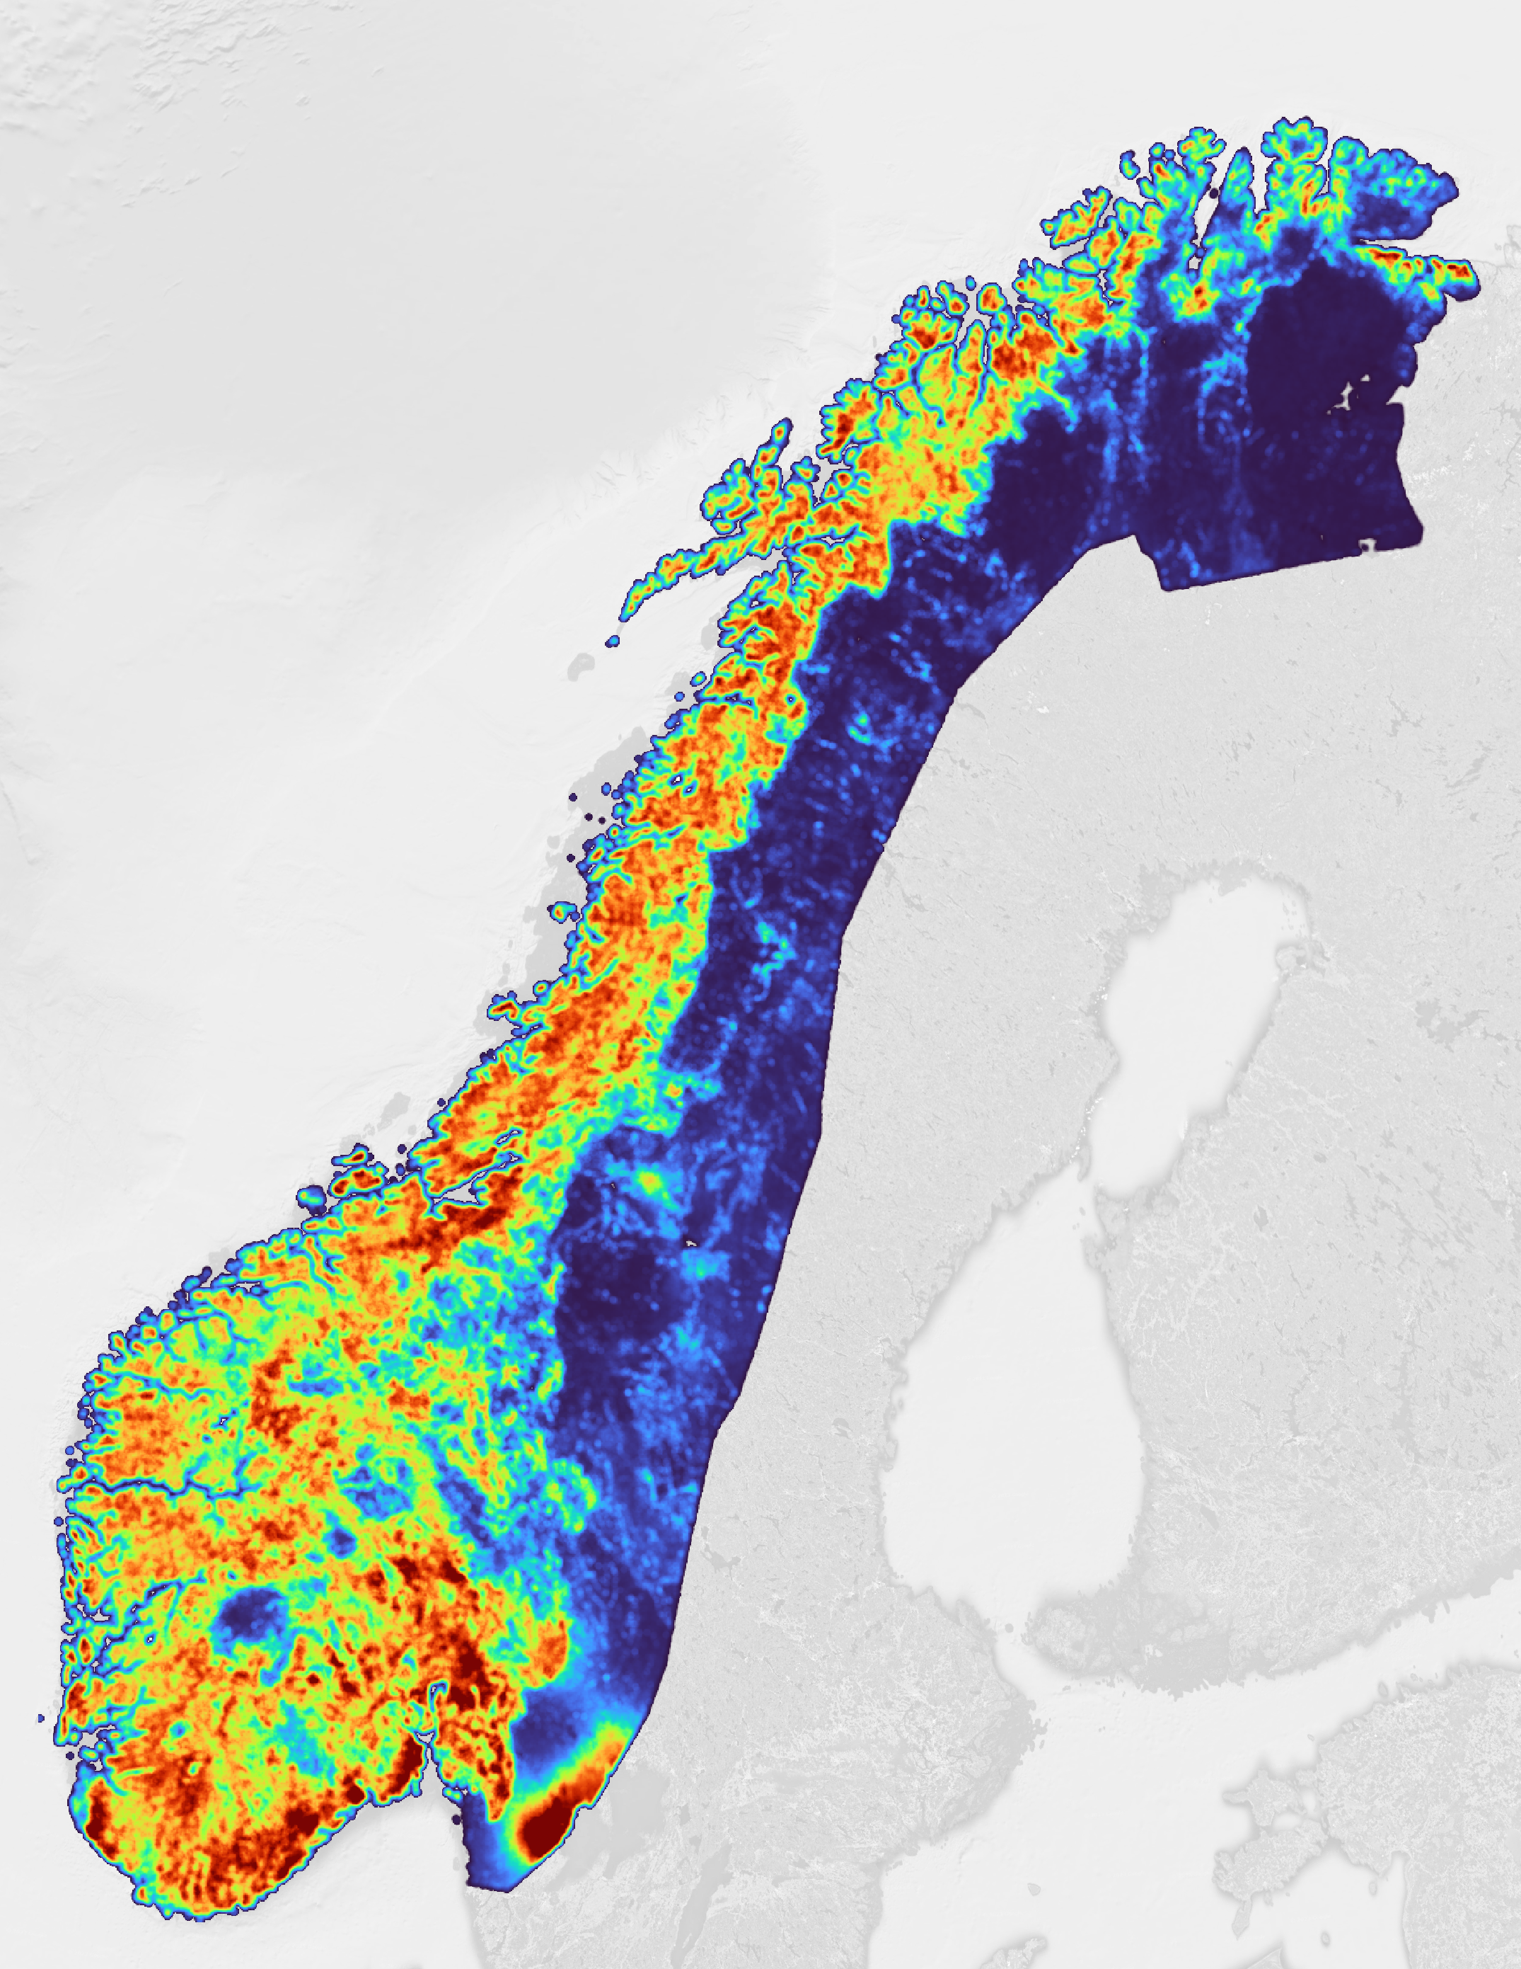
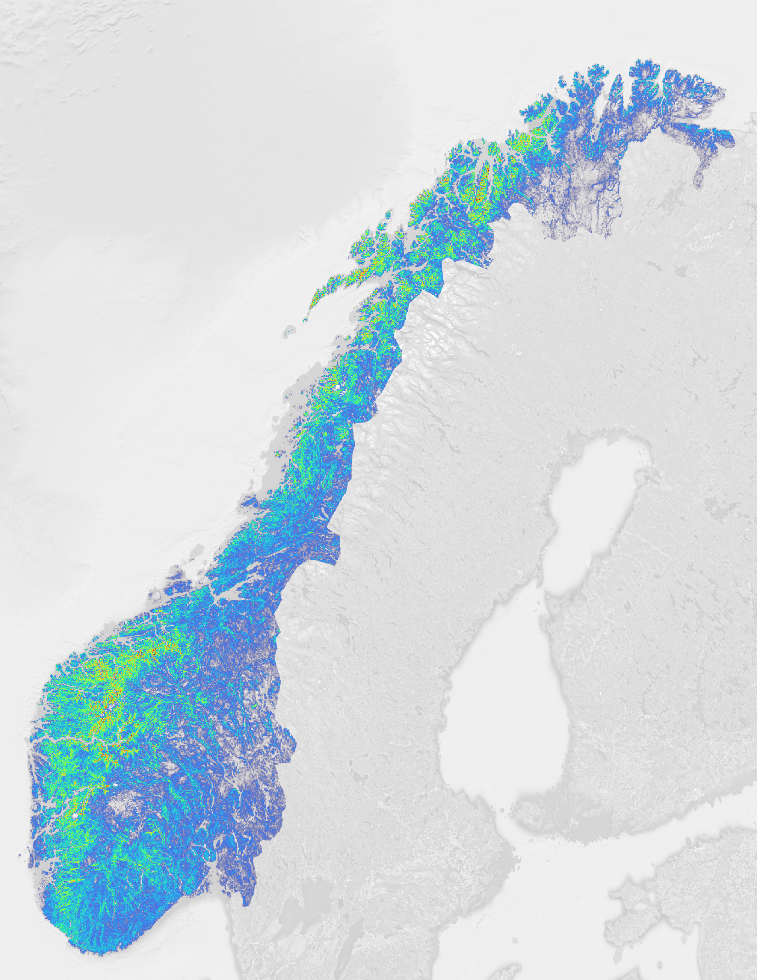
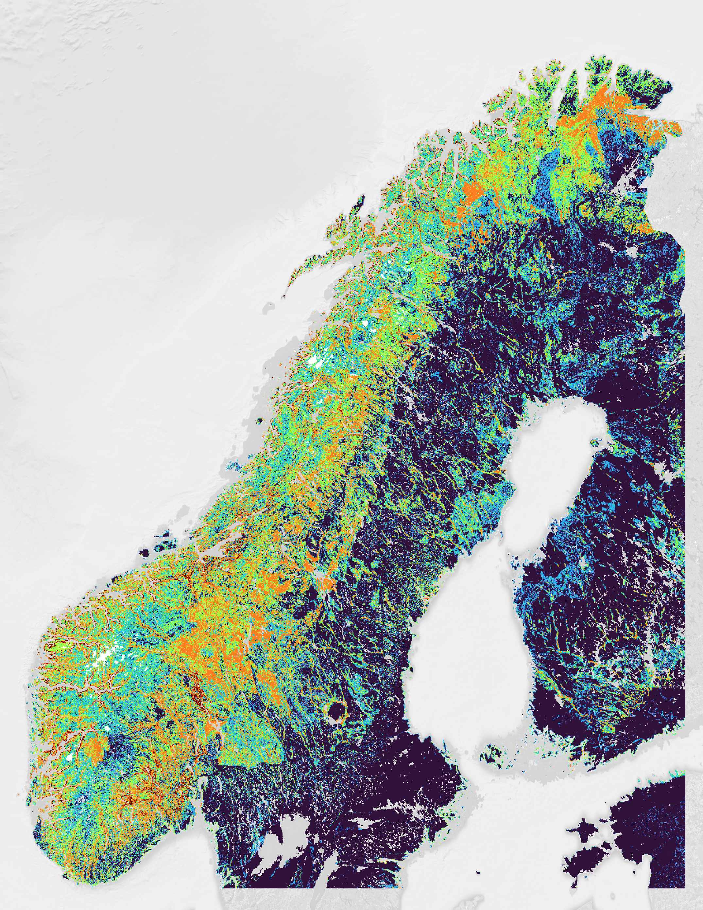
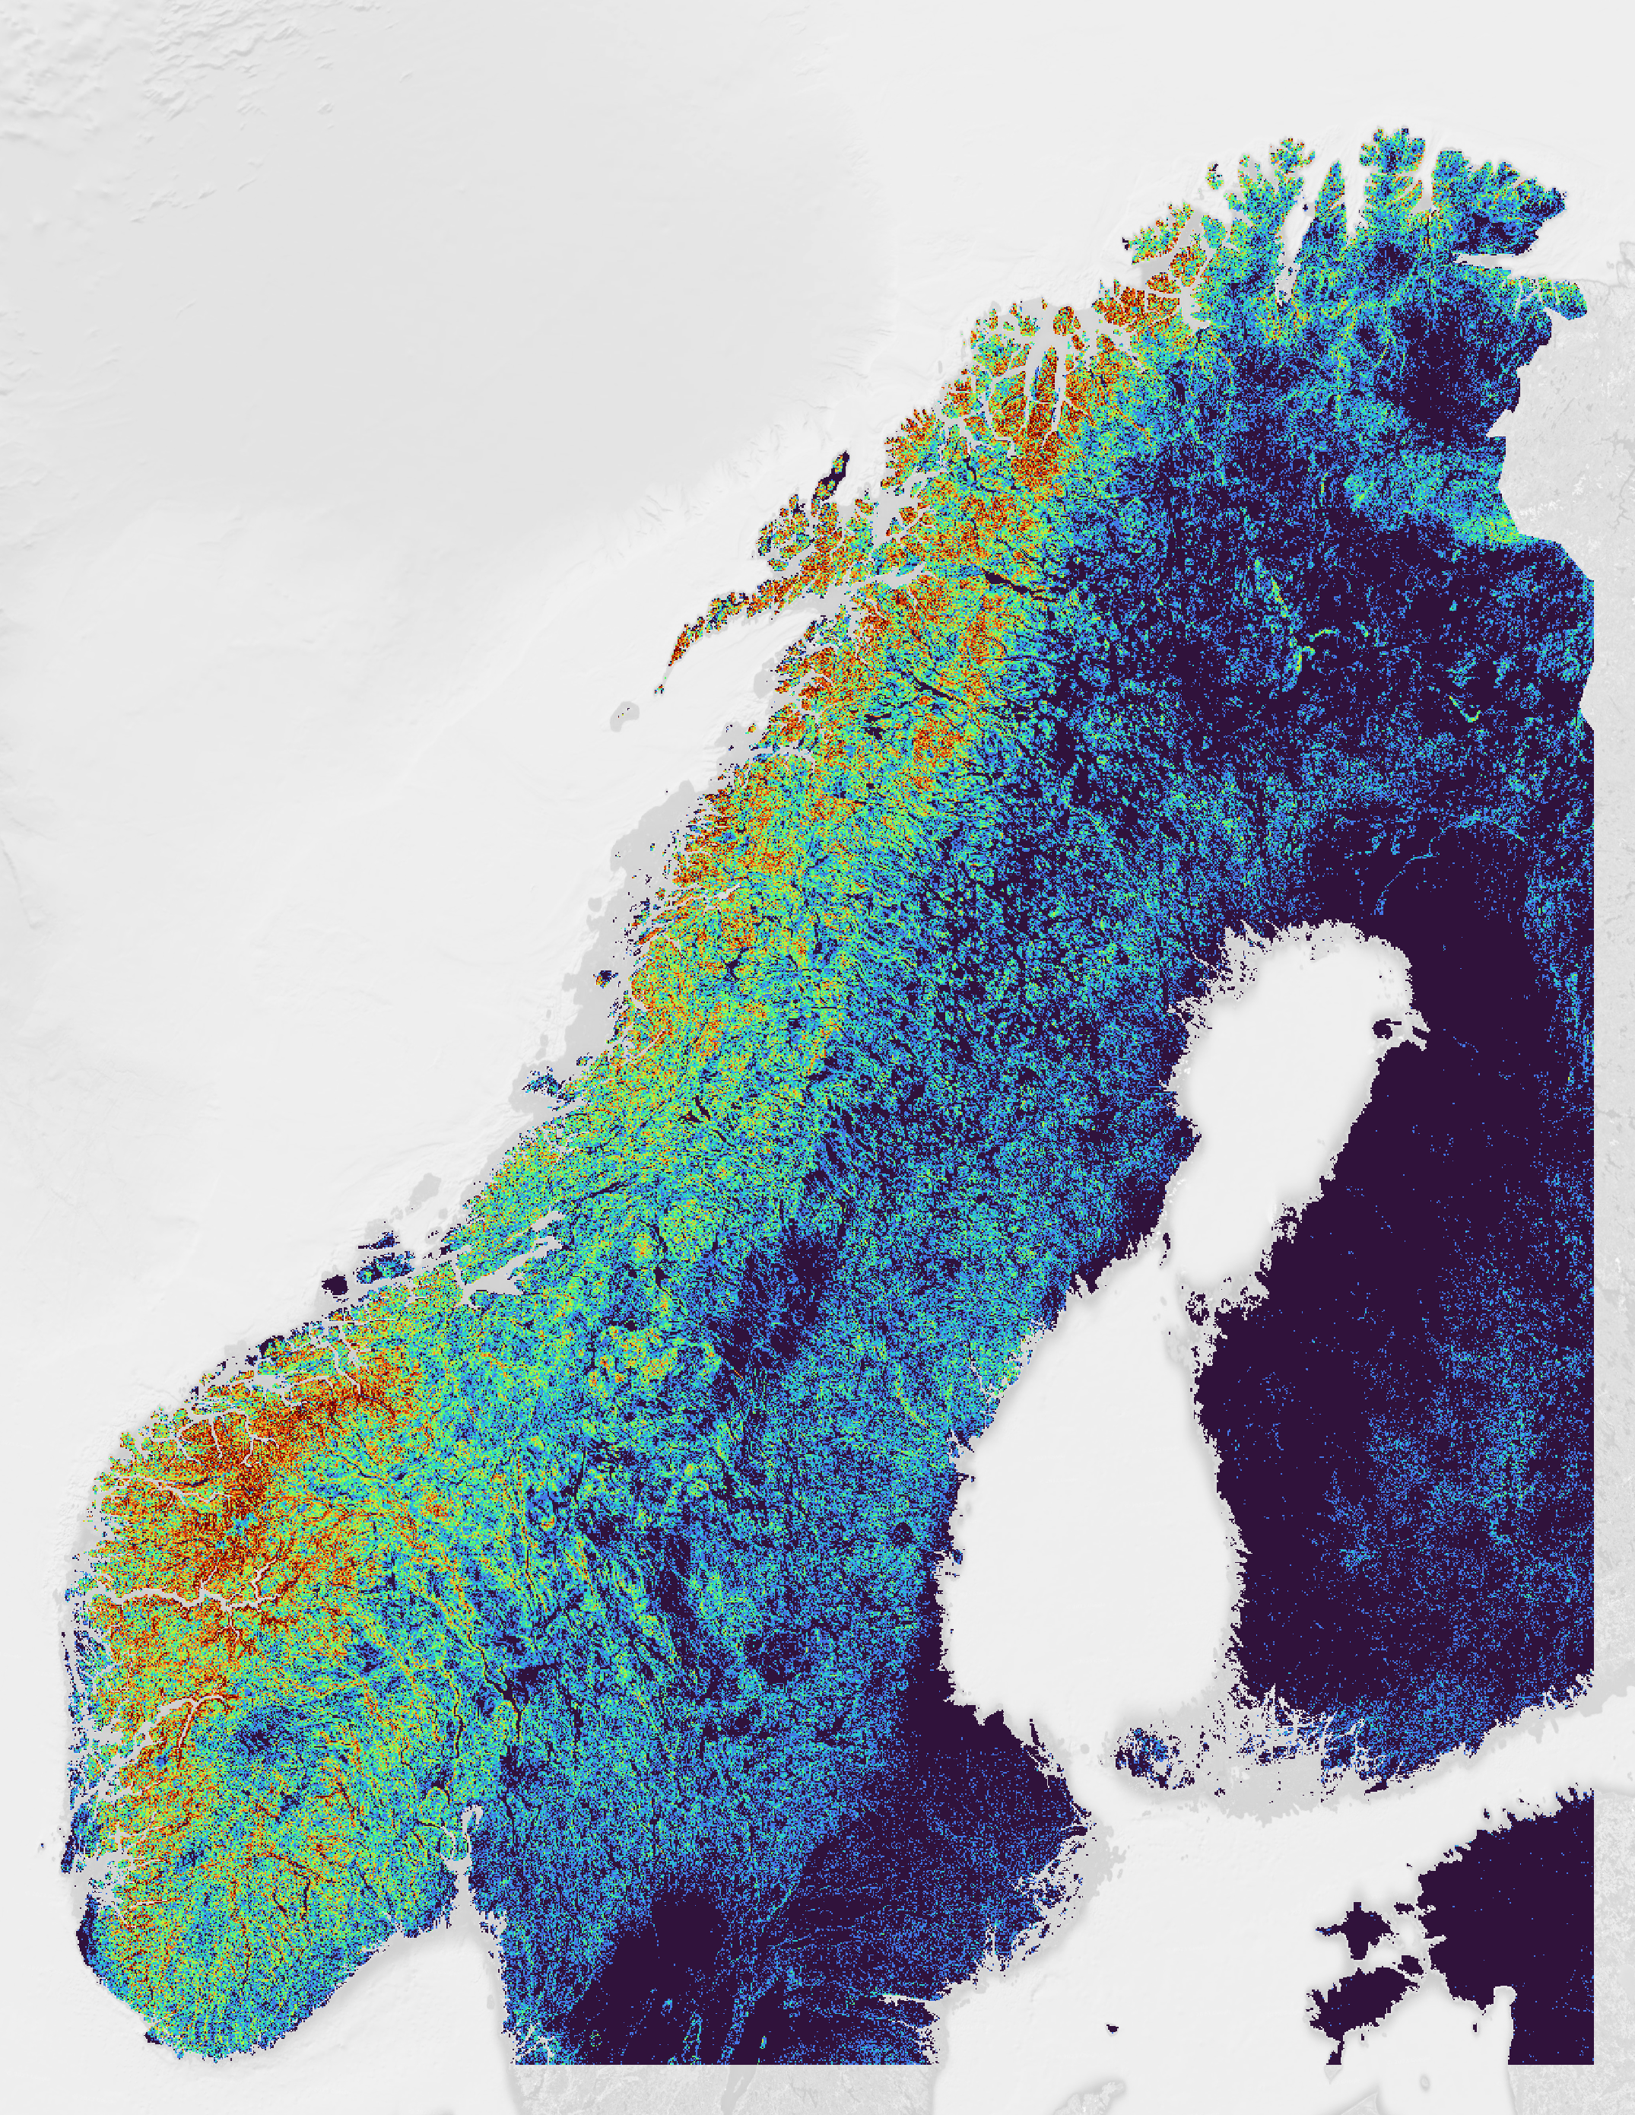
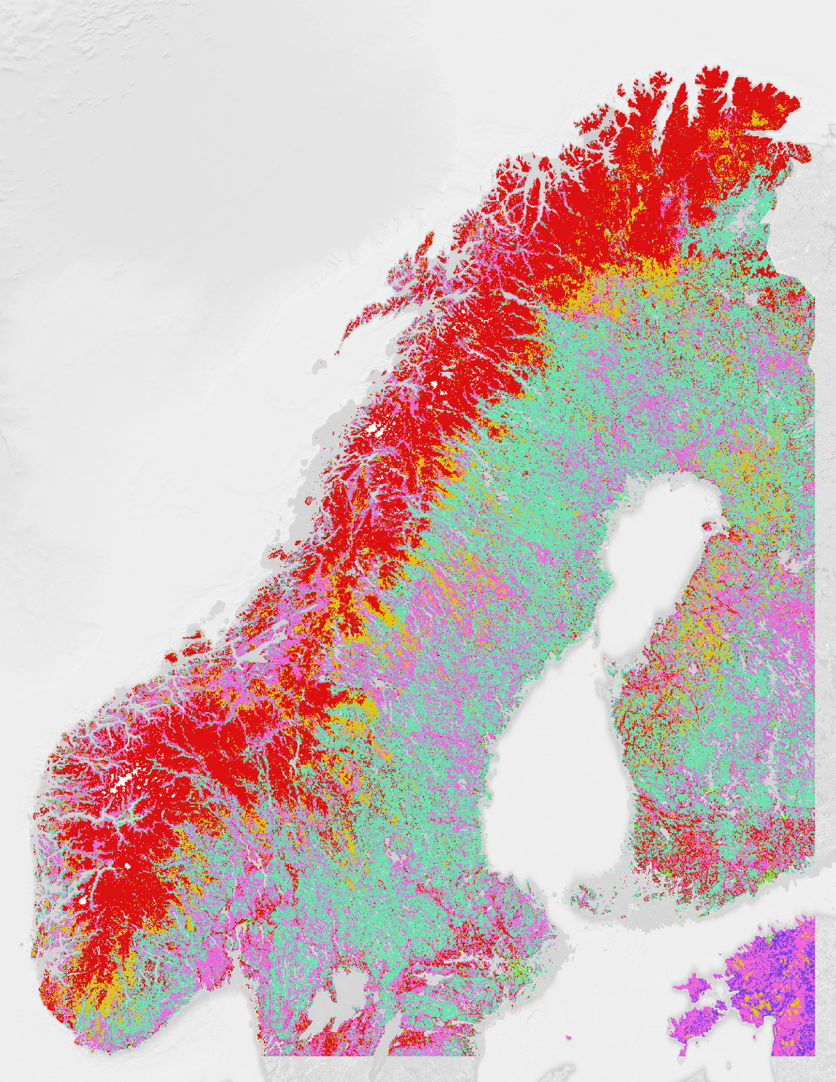
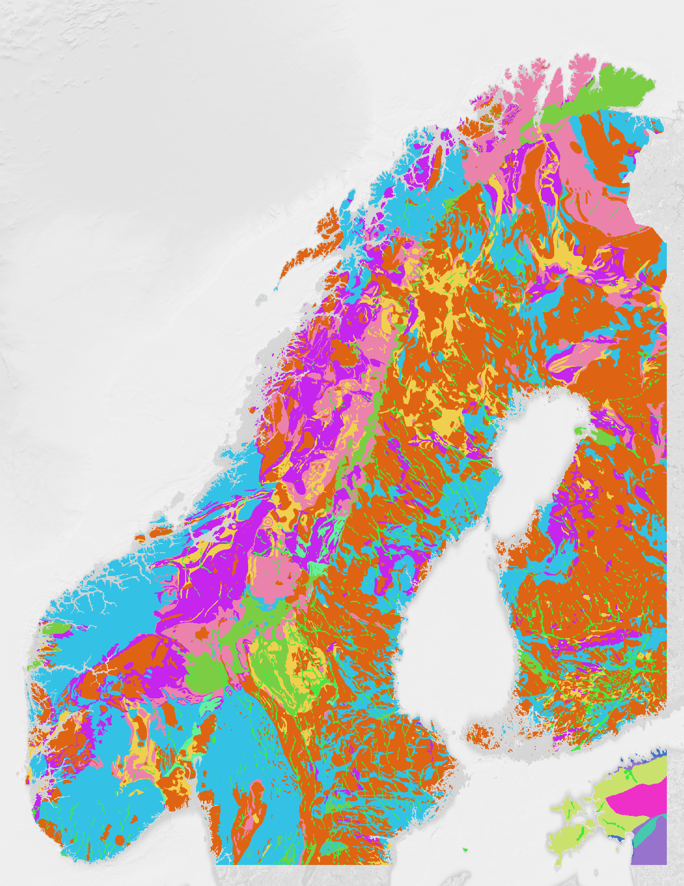
a
b
c
d
e
k
l
46
5.9
1.1k
5.1k
254
0
-15
0
0
0
f
g
h
i
j
61
5
8
1
0.24
1.5
1
1
0
0
Map Data ©2023 Google

Slide 5
a
b
c
d
e
46
5.9
1.1k
5.1k
254
0
-15
0
0
0
f
g
h
i
j
61
5
8
1.5
1
1
k
l
1
0.24
0
0
Map Data ©2023 Google

Slide 6
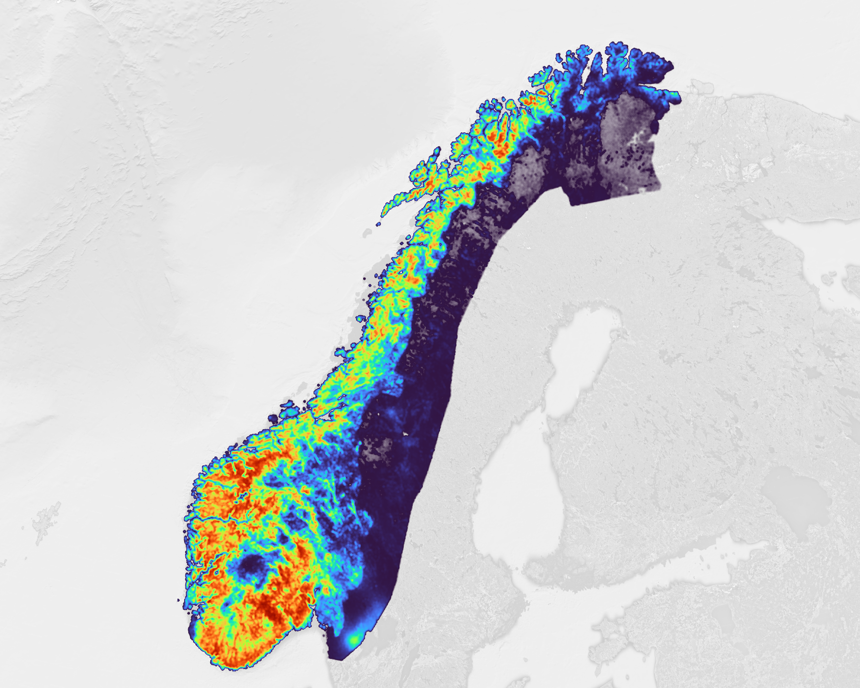
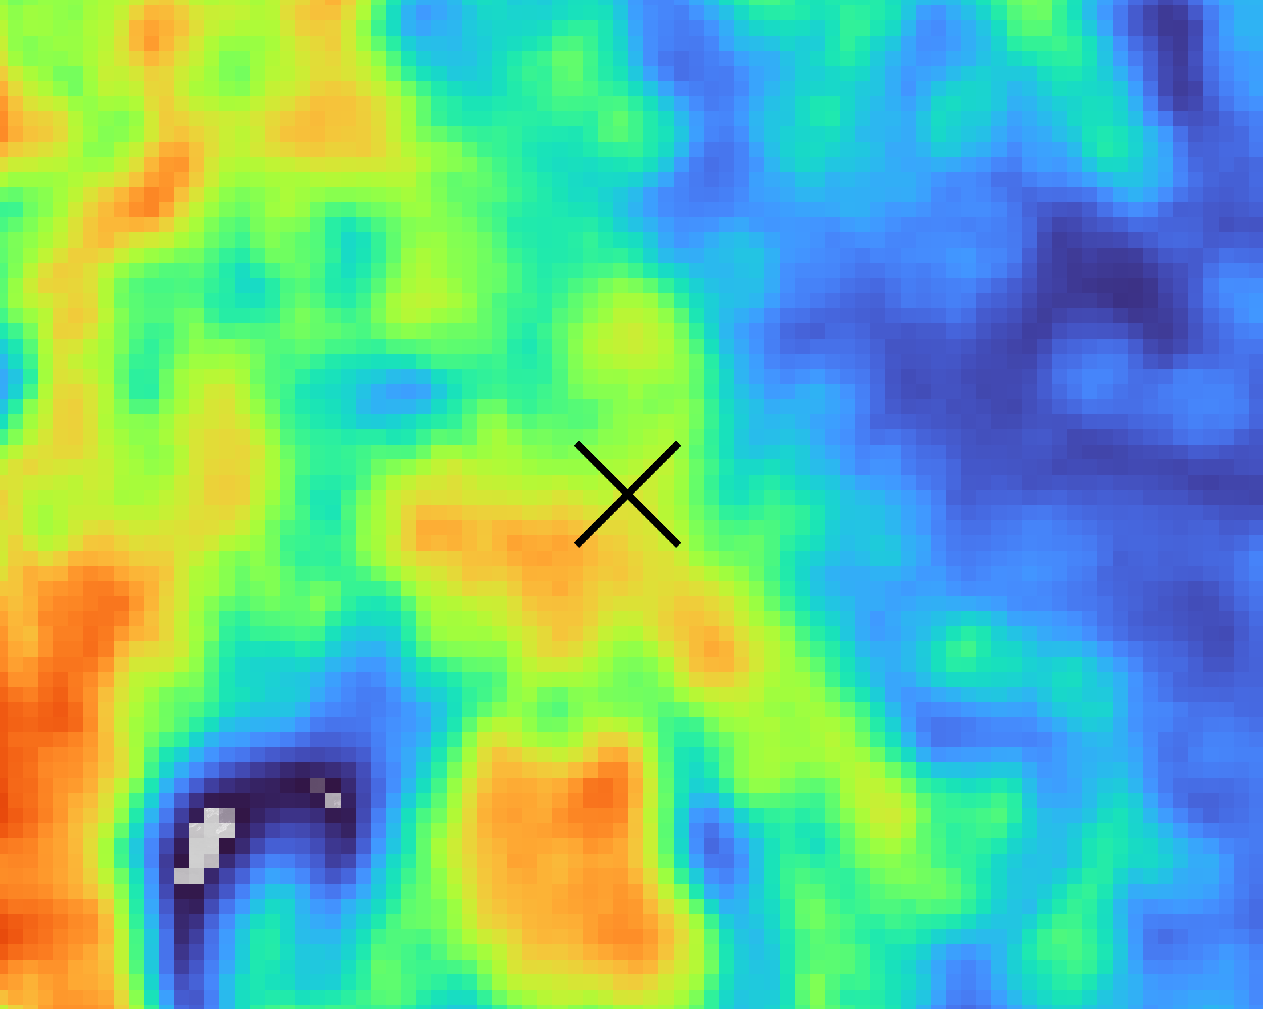
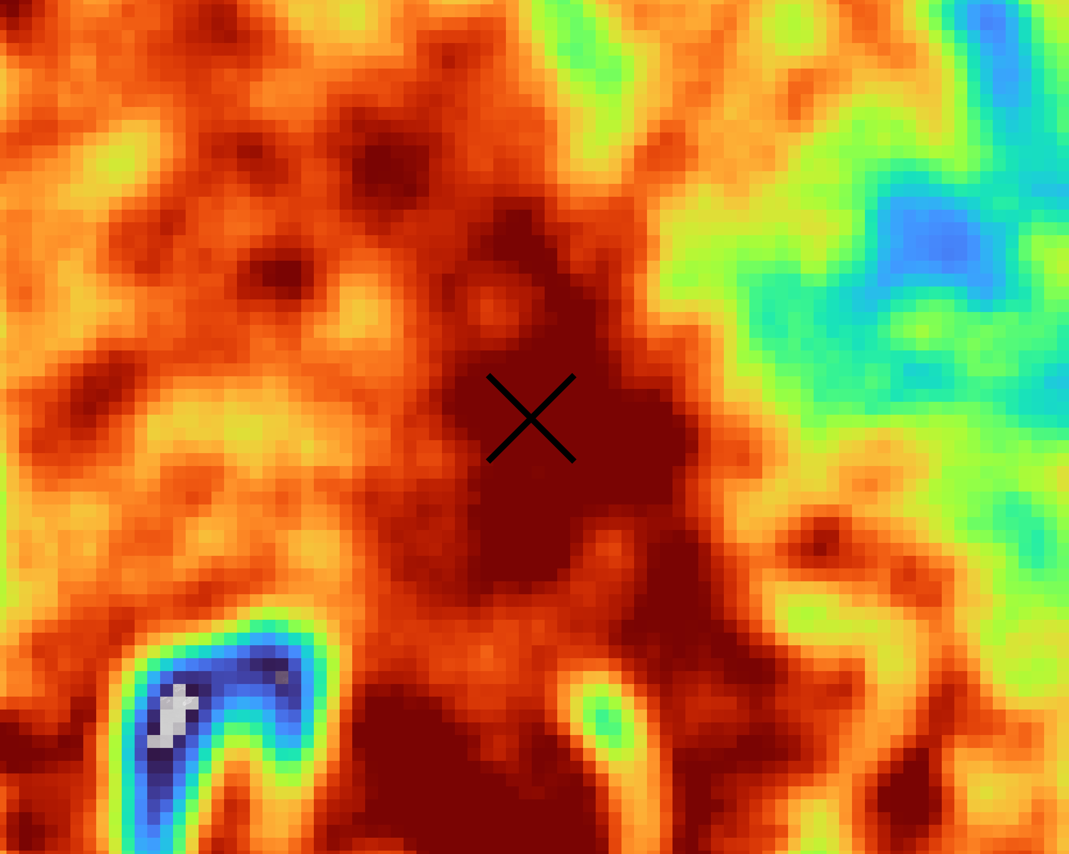
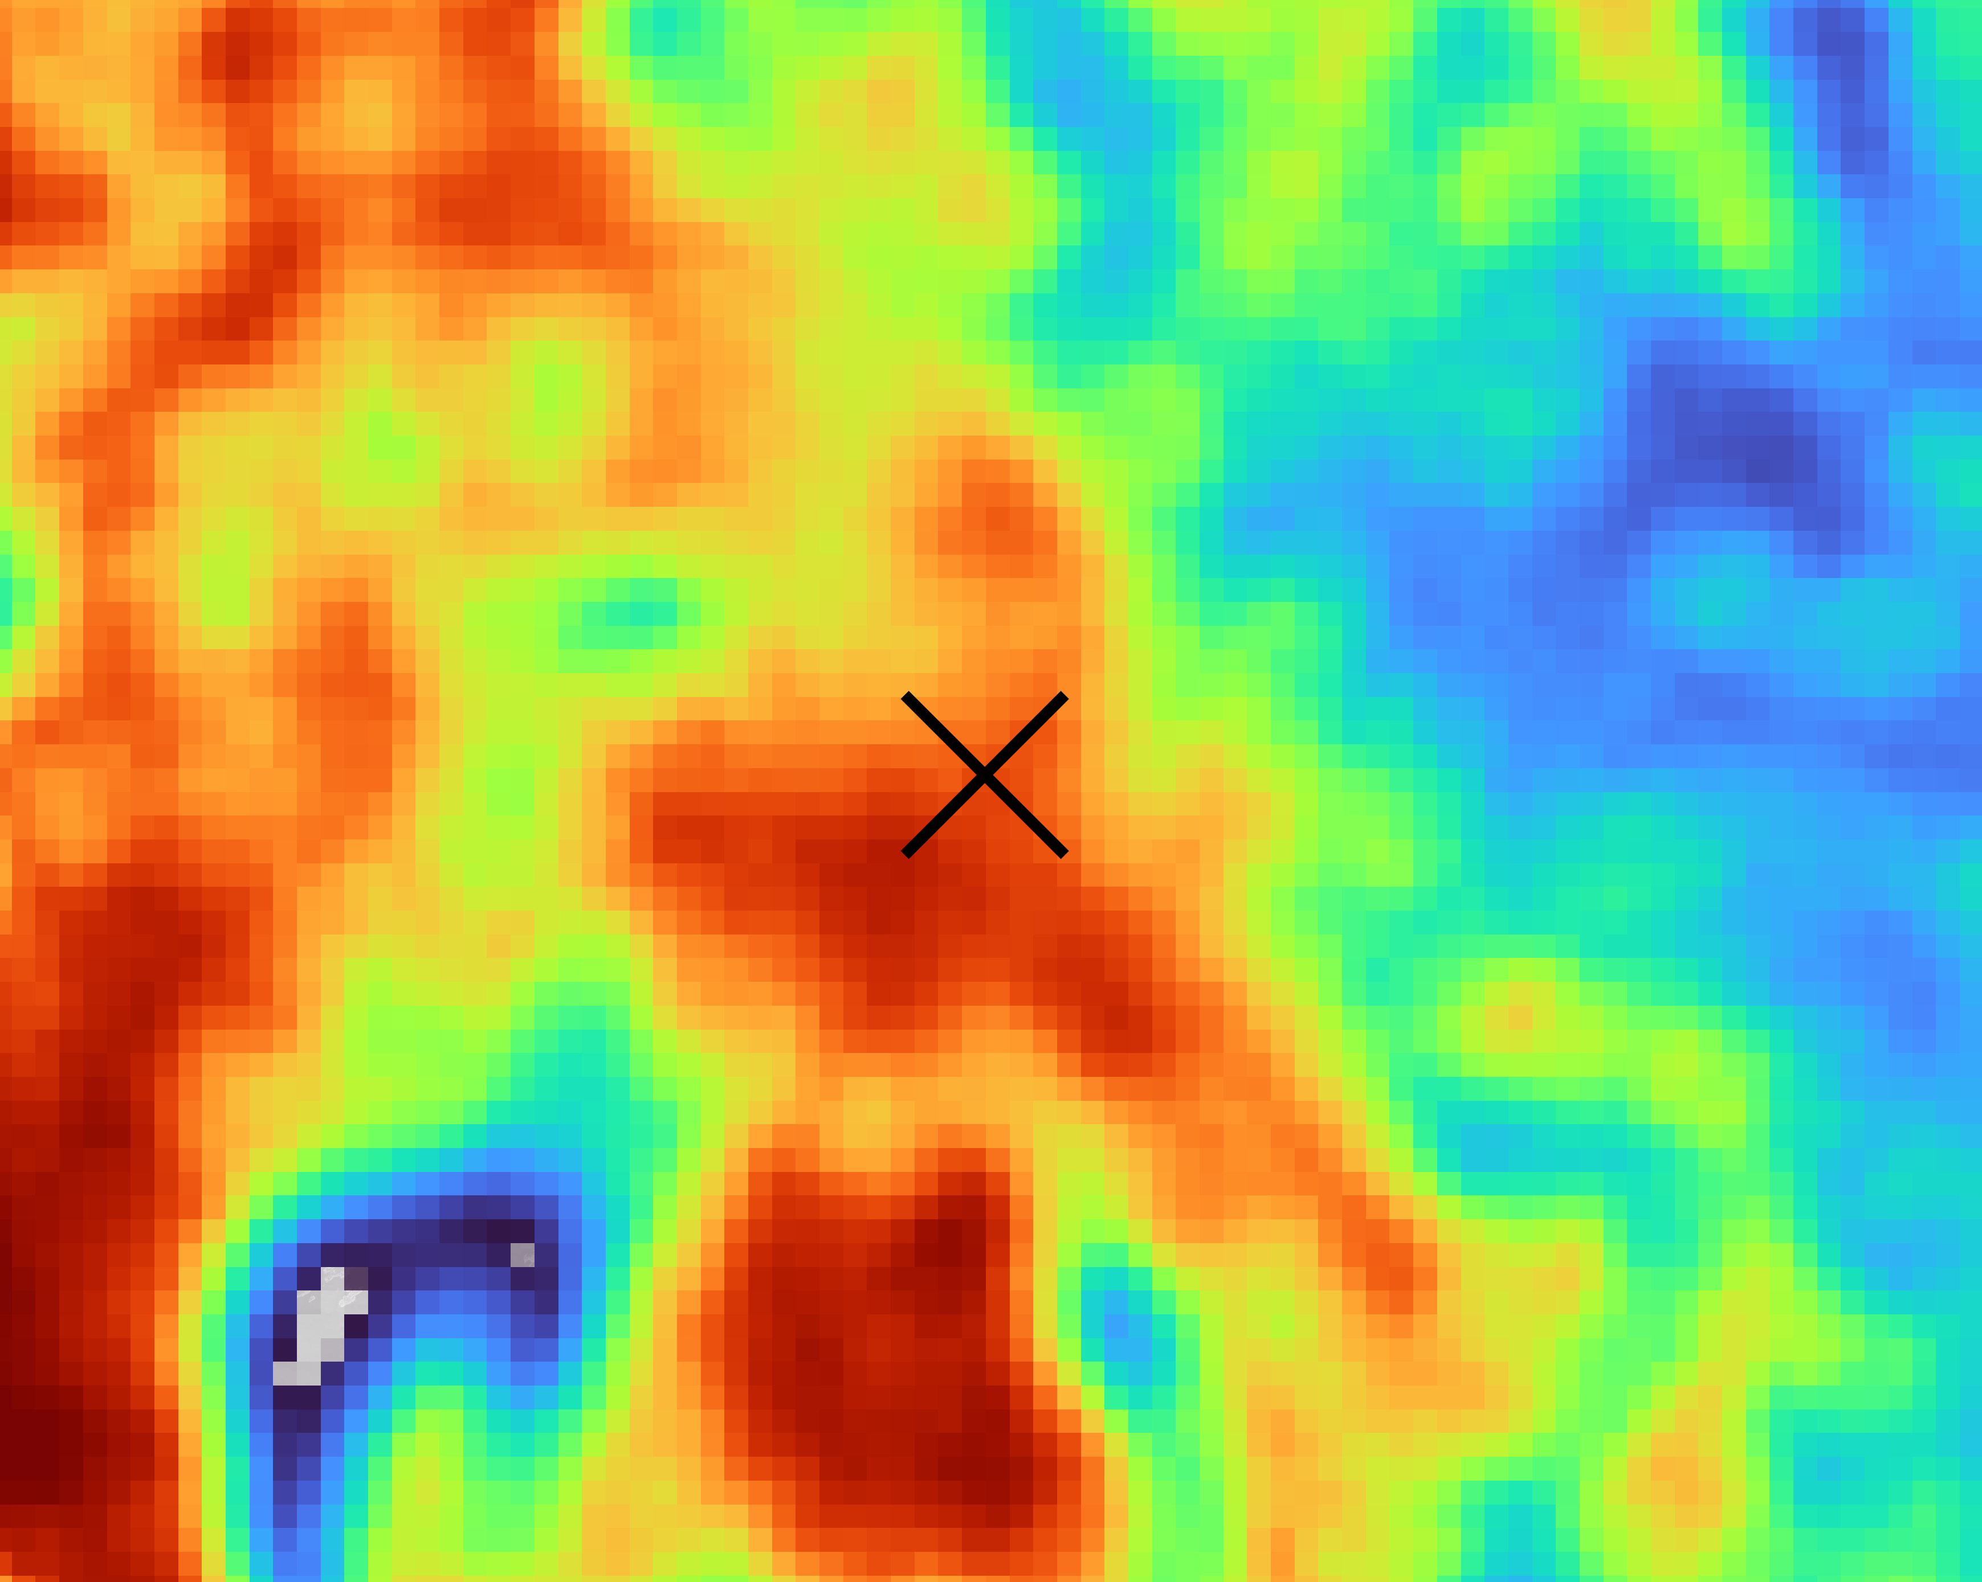
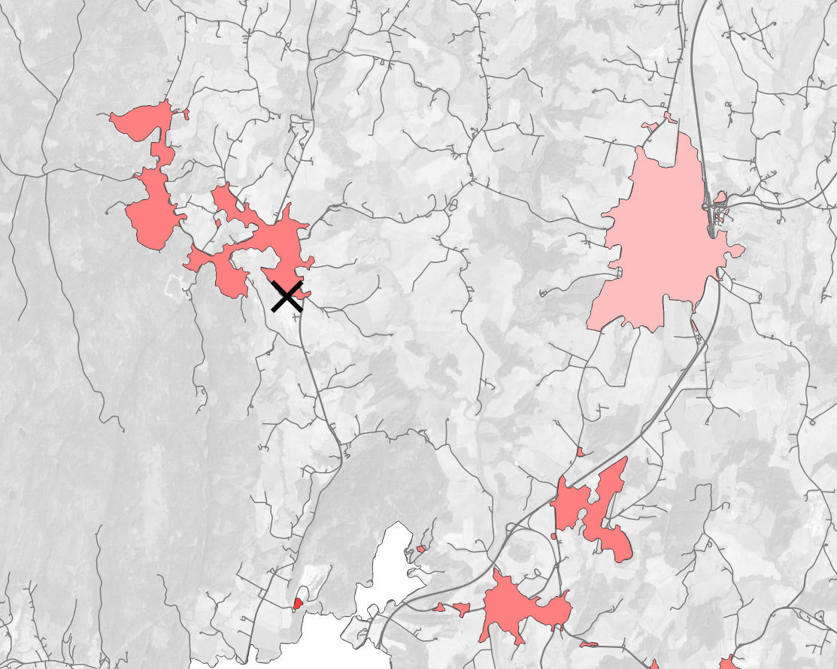
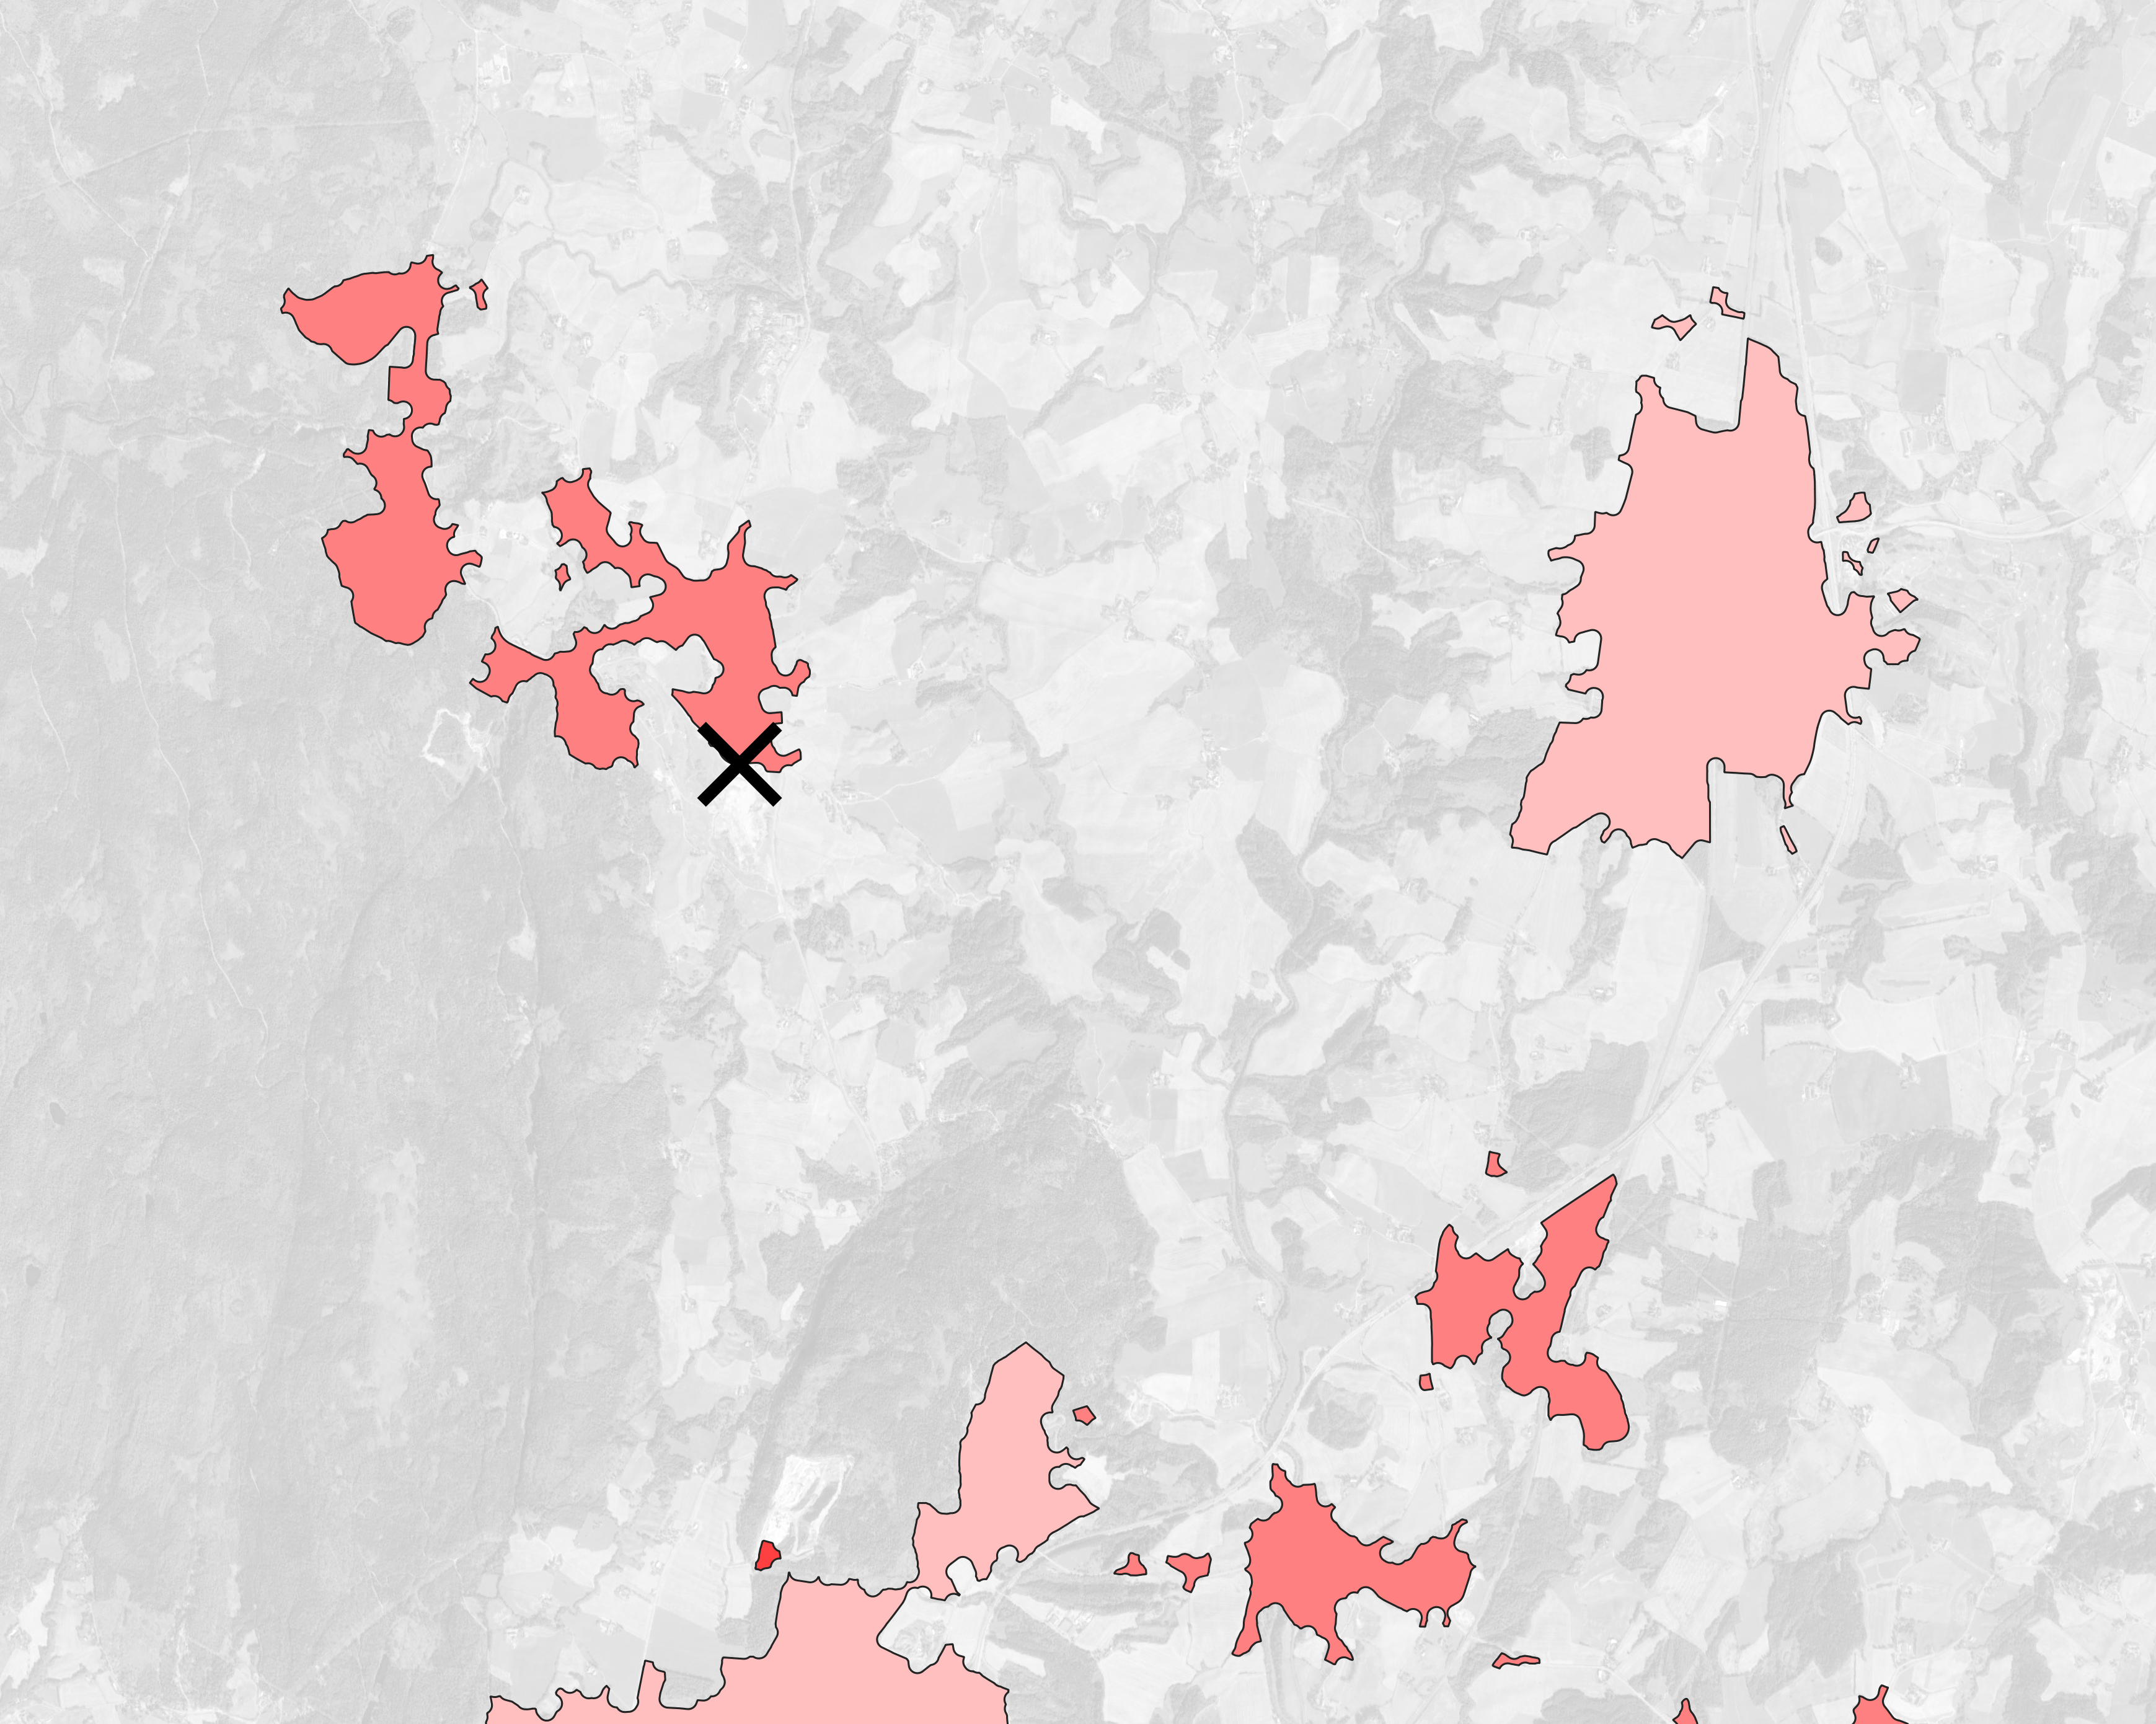
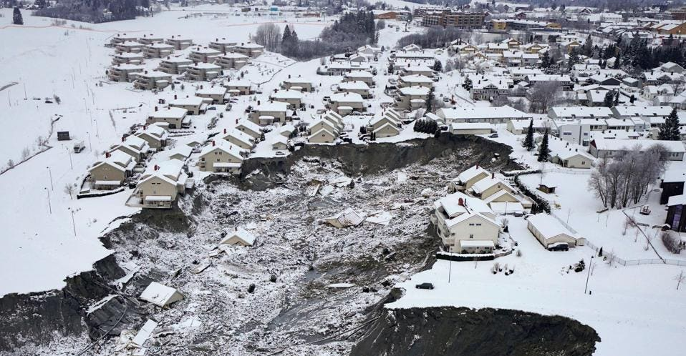
a
c
1
d
0.24
e
1
(f-g)
0
(f-g)
0
(f-g)
0
(b)
(b)
(b)
f
Grønlund
50th: 56%
84th: 81%
Kløfta
50th: 39%
84th: 64%
g
Grønlund
50th: 55%
84th: 80%
Kløfta
50th: 38%
84th: 63%
(c-e)
1
0
(b)
(b)
b
Lindeberg
50th: 49%
84th: 75%
Lindeberg
50th: 47%
84th: 73%
Oslo
50th: 18%
84th: 34%
Frogner
50th: 58%
84th: 83%
Oslo
50th: 36%
84th: 55%
Frogner
50th: 57%
84th: 82%
© NTB/AFP via GETTY Images
Map Data ©2023 Google

Slide 7
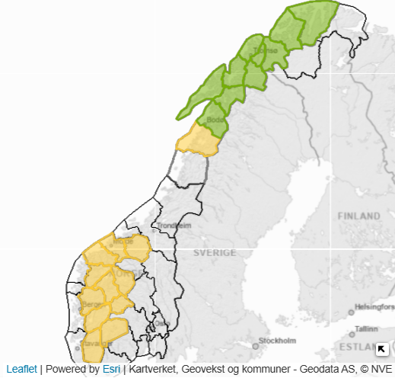
■ Not
■ Low
■ Moderate
■ Considerable
■ High
■ Very high
1
0
Map Data
©2023 Google

Slide 8
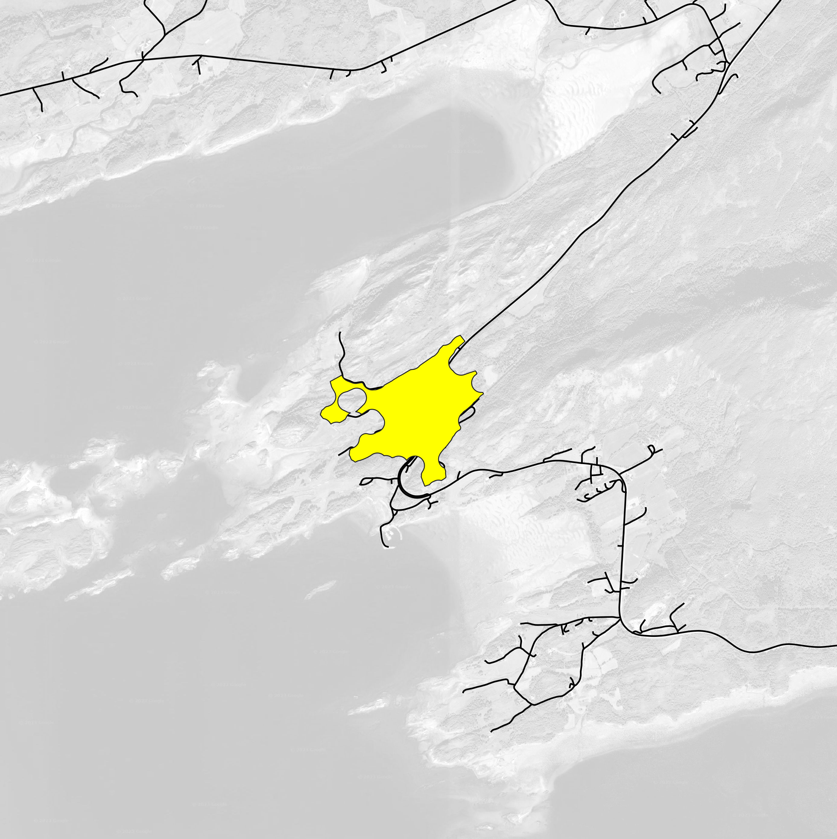
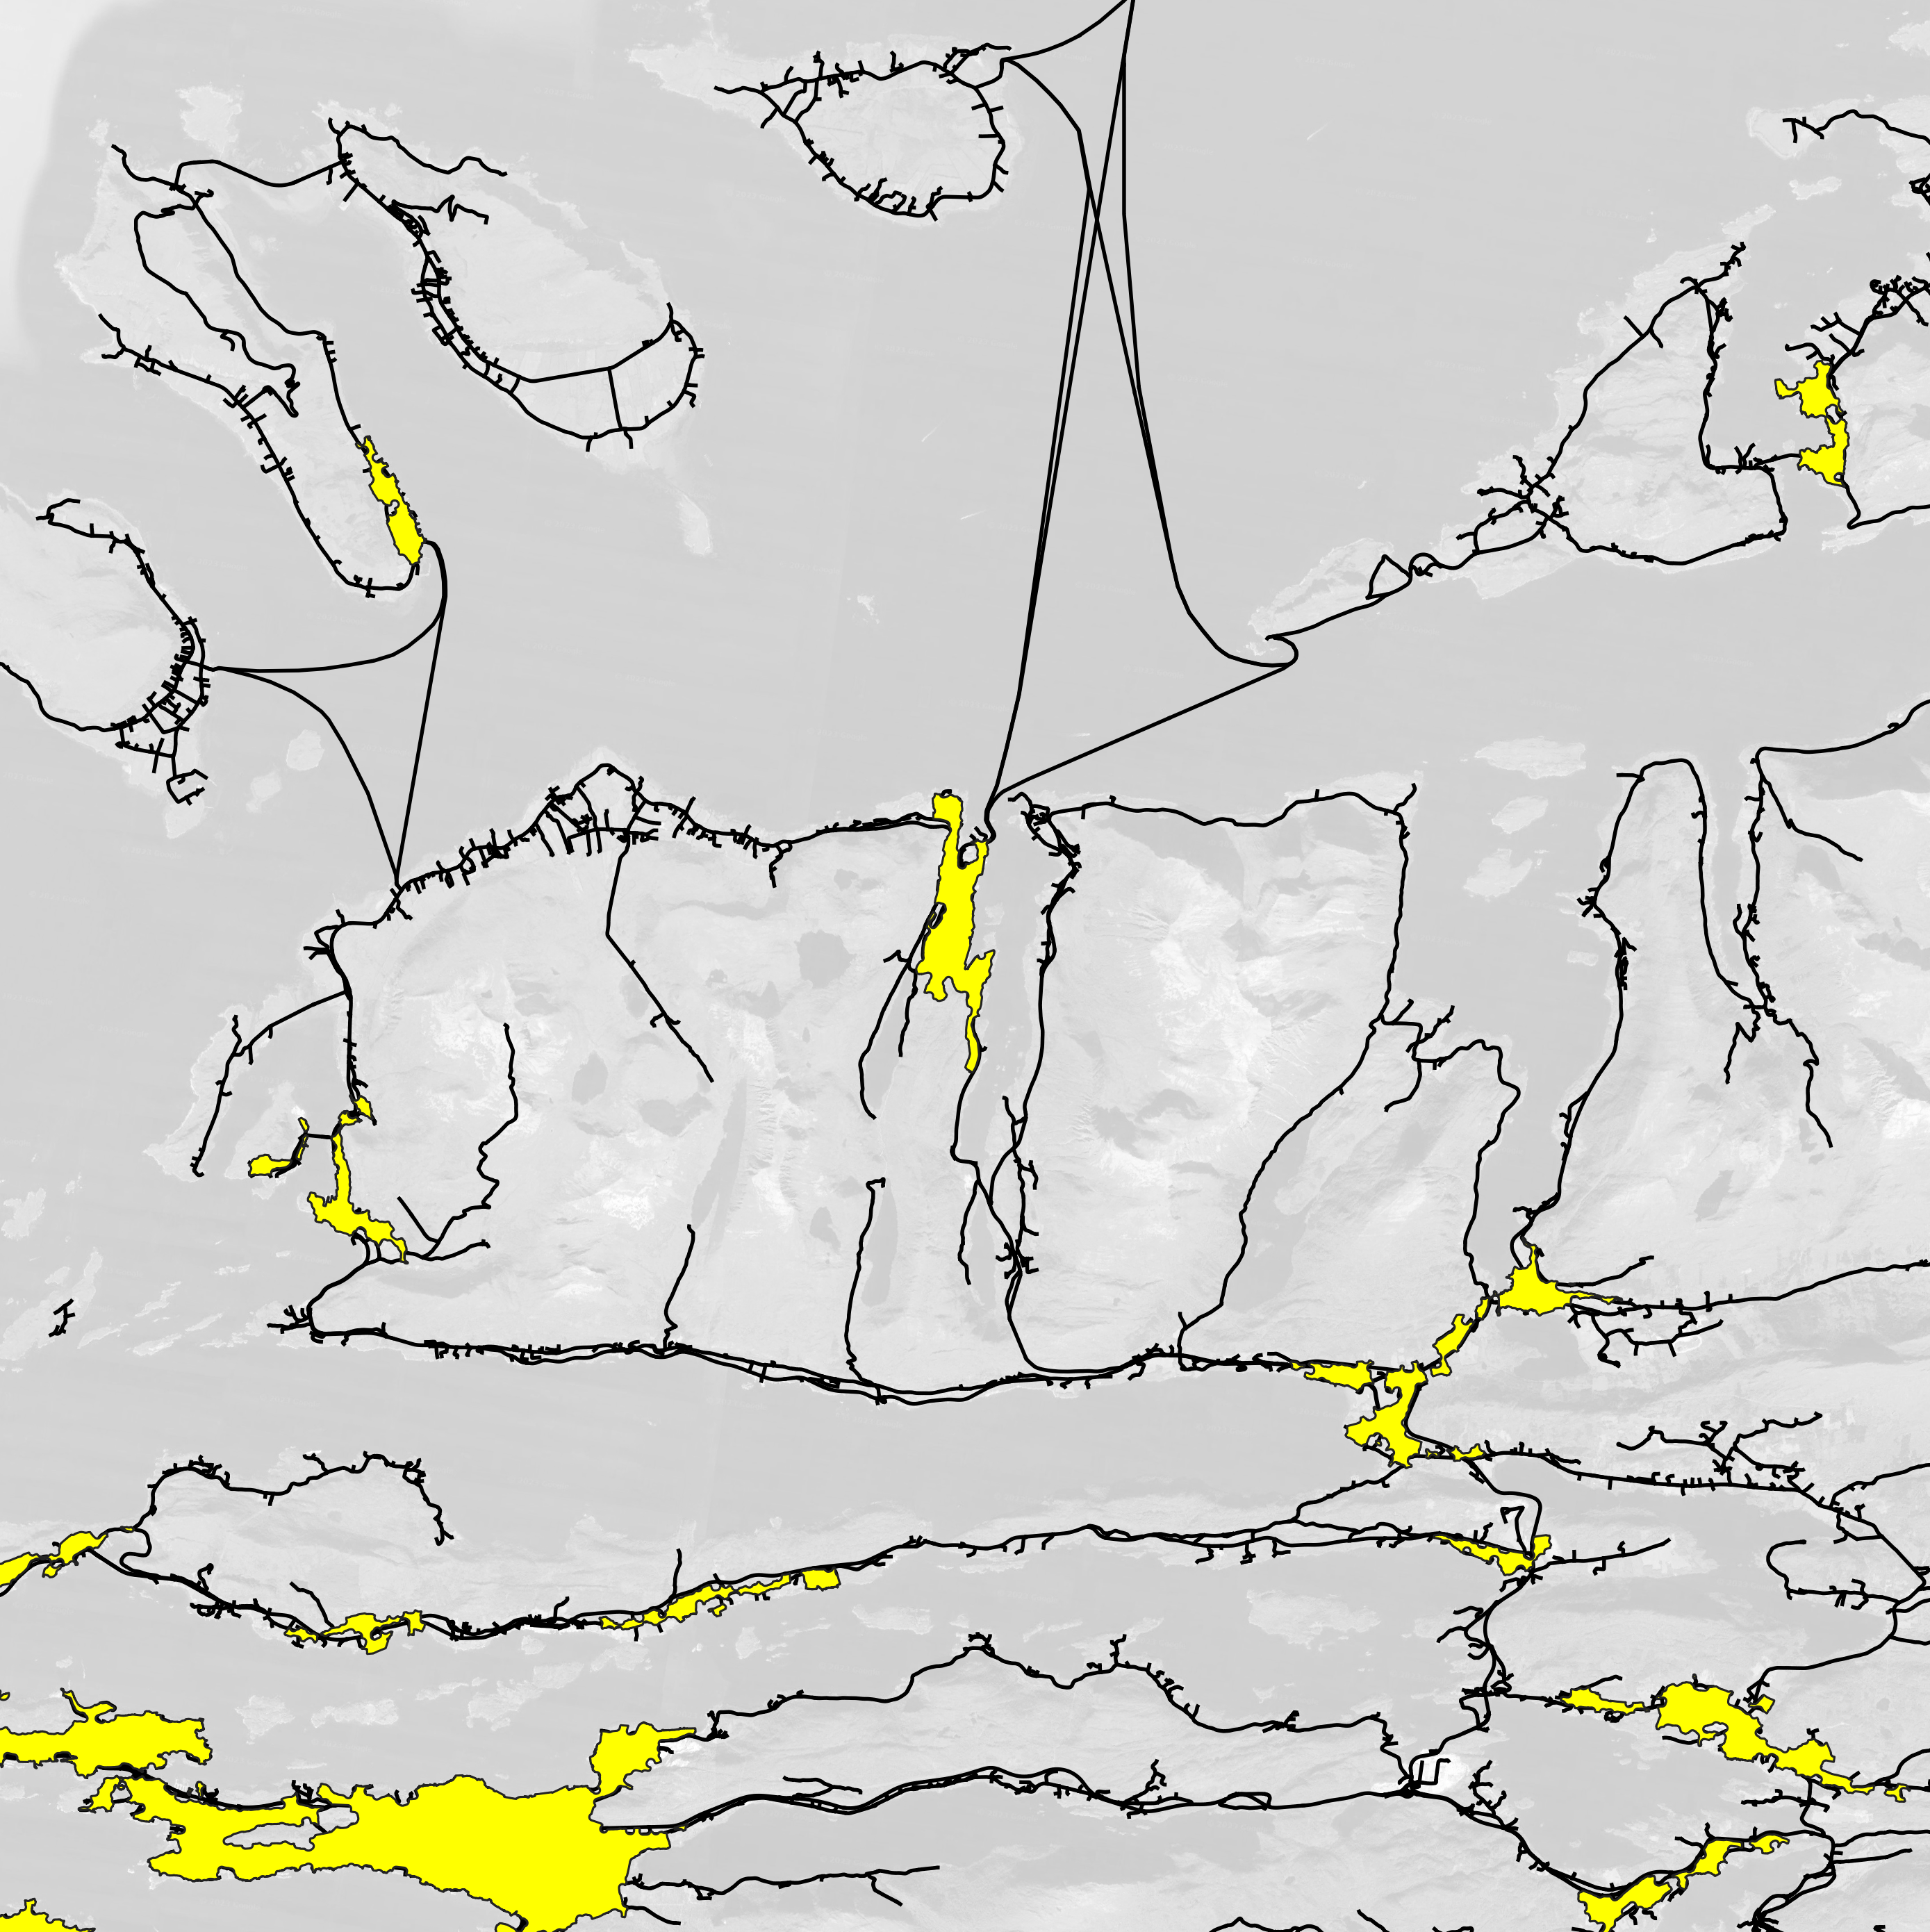
Leinesfjord
Inter = 69%
Intra = 21%
Brattvåg
Inter = 35%
Intra = 53%
Map Data ©2023 Google

Slide 9
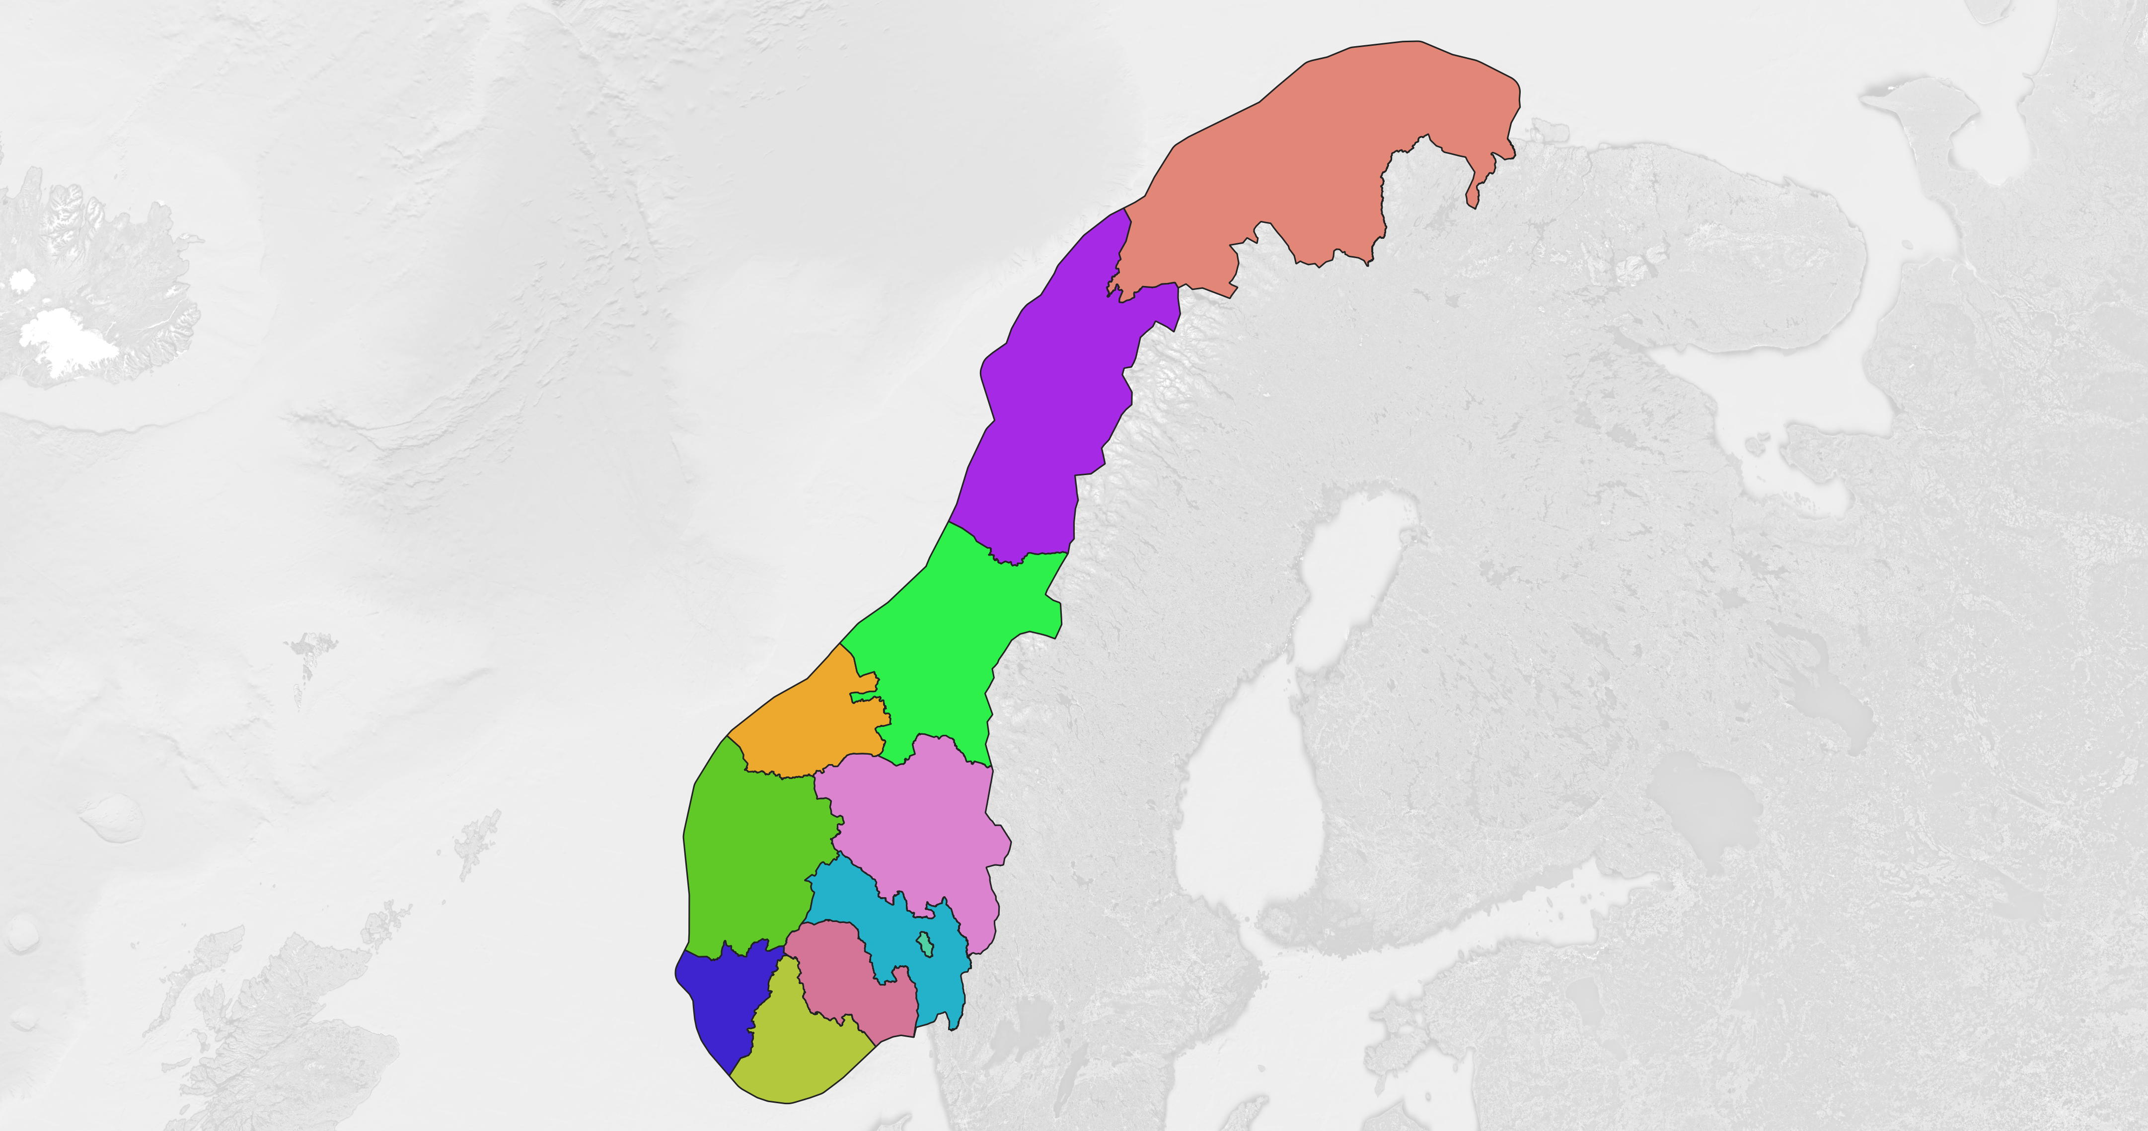
Map Note: The calculated areas of the polygon are not indicative of declared exact administrative areas.
Troms og Finnmark
~115,800 km²
Nordland
~80,600 km²
Trøndelag
~60,000 km²
Innlandet
~52,100 km²
Møre og Romsdal
~25,500 km²
Viken
~25,800 km²
Vestland
~49,600 km²
Oslo
~481 km²
Vestfold og Telemark
~20,200 km²
Rogaland
~16,500 km²
Agder
~23,000 km²
Map Data ©2023 Google, Administrative Boundaries ©2022 GADM

Slide 10
Data Preparation
c
Supervised Ensemble Graph Neural Network
Unsupervised Spectral Graph Clustering
Grid discretization
geographical proximity
attribute
similarity
Input prediction date
Input county-level mask, settlement, road networks
Sample features and labels
Construct two kinds of graphical structure or adjacency matrix
Trained ensemble model
Construct adjacency matrix based on simplicial networks
Randomly subdivide into 32 smaller subdatasets
Susceptibility Map
Shortest path
Construct a new adjacency matrix with settlement as nodes
Train a graph neural network
Maximum value along the shortest path as weight
Transform into weighted unnormalized Laplacian matrix
Split each subdataset
(train, test, validation)
Perform efficient multi-step hyperparameter search
Inter- and Intra- Settlement Exposure Probability
Perform iterative K-means clustering

Slide 11

Supervised Ensemble Graph Neural Network
Unsupervised Spectral Graph Clustering
Attribute-aware Graph
Predicted Susceptibility Values
Randomly sampled point from the map
(70%)
(60%)
70%
Neighborhood-aware Graph
(95%)
(30%)
95%
50%
(50%)
(each point has a feature vector and geographical location
information)
The nodes are 1km-by-1km
grid point.
overlay the map on settlement and
road patterns
The nodes
are settlements and
roads are edges.

